Slide 1
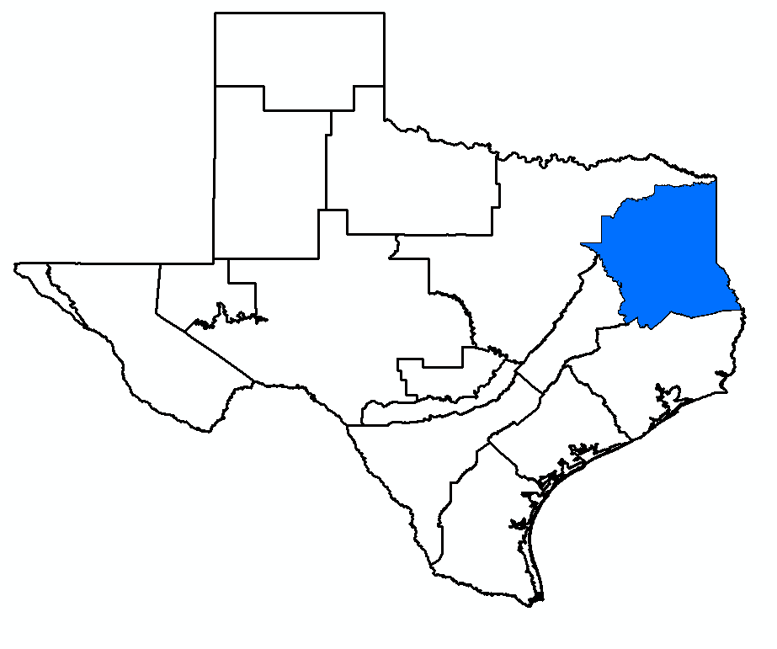
GMA 11 Joint Planning
Agenda Item 5:
Summary of Draft Tech Memo 26-03 (Five New GAM Simulations)
William R. Hutchison, Ph.D., P.E., P.G.
GMA 11 Meeting
October 7, 2026

Slide 2
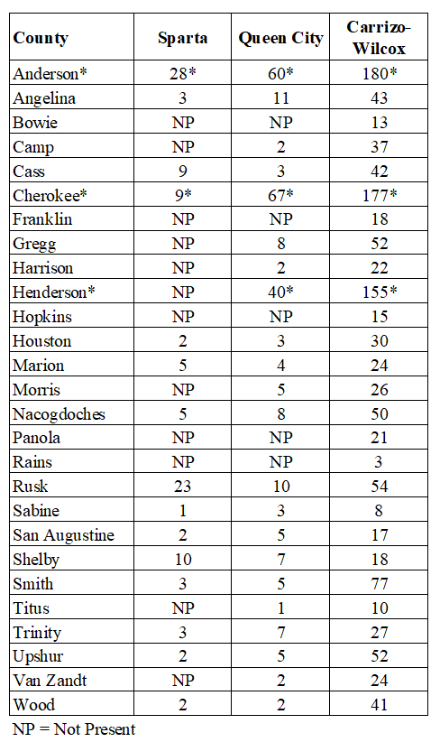
Background
GMA 11 approved Proposed DFCs on April 28, 2026
  Average drawdown (by aquifer and county) from 2014 to 2080:
    Scenario 33 for NTVGCD counties (Anderson, Cherokee, and Henderson)
    Scenario 26.1 for all other counties
“Frankenstein” approach due to statutory deadline and in response to comments from NTVGCD and public comments, (including members of the legislature)
  No “DFC” Comments (comments on pumping/MAG in NTVGCD)
During the meeting, it was acknowledged/known that the proposed DFCs are not realistic and new GAM simulations were completed to ensure that DFC values were “feasible” (Joint Planning Factor 7)
  Proceeded since there was a plan to run additional GAM runs with updated pumping in NTVGCD and adjust “proposed DFCs” accordingly
  Five new simulations documented in Technical Memo 26-03

Slide 3
Overview of TM 26-03
Documentation of Scenarios 26.2 to 26.6
Reports sections:
  Section 2: Documentation of pumping input files for scenarios
  Section 3: Pumping output results for all scenarios
  Section 4: Average drawdown results for all scenarios
  Section 5: Dry well analysis for all scenarios
  Section 6: Groundwater budget analysis for all scenarios
  Section 7: References
Link to Google Drive for all files:
https://drive.google.com/drive/folders/1Aq9XijsHklgBJuUdw7Tl1Lc2JiCHkIlm?usp=sharing

Slide 4
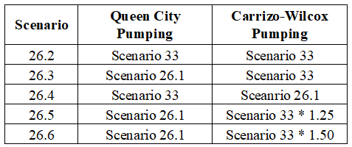
Summary of Five New Simulations
Pumping in Non-NTVGCD Counties: Scenario 26.1
Pumping in NTVGCD Counties:

Slide 5
Overview of Results Comparison
Report includes summary results by aquifer and county for:
  Pumping (county and aquifer)
  Average drawdown (county and aquifer)
  Dry well analysis by county (overall and Carrizo-Wilcox)
  Groundwater budget analysis by river basin
    Complete groundwater budget
      Inflow from alluvium
      Interbasin flow
Google Drive link includes all files used in preparing summary documentation

Slide 6
Scenario Comparison
Baseline
Scenario 33 (basis for current DFC adopted in 2021)
Scenario 26.1
Scenario 26.2
Scenario 26.3
Scenario 26.4
Scenario 26.5
Scenario 26.6

Slide 7
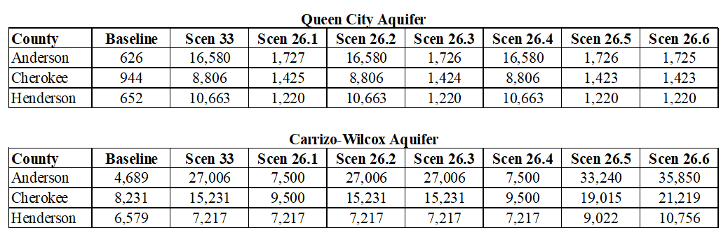
Pumping Comparison
2080 Pumping (AF/yr) for NTVGCD Counties for each scenario in Queen City and Carrizo-Wilcox Aquifers

Slide 8
Pumping Comparison
For NTVGCD:
Scen 26.2 = Scen 33 (QC and CW)
2080 Pumping (AF/yr) for NTVGCD Counties for each scenario in Queen City and Carrizo-Wilcox Aquifers

Slide 9
Pumping Comparison
For NTVGCD:
Scen 26.3 = Scen 26.1 (QC)
Scen 26.3 = Scen 33 (CW)
2080 Pumping (AF/yr) for NTVGCD Counties for each scenario in Queen City and Carrizo-Wilcox Aquifers

Slide 10
Pumping Comparison
For NTVGCD:
Scen 26.4 = Scen 33 (QC)
Scen 26.4 = Scen 26.1 (CW)
2080 Pumping (AF/yr) for NTVGCD Counties for each scenario in Queen City and Carrizo-Wilcox Aquifers

Slide 11
Examples of Proposed DFC with Average Drawdown Results from Two Scenarios
Scenario 26.2
  NTVGCD pumping = Scenario 33 (all aquifers)
  Non-NTVGCD pumping = Scenario 26.1
Scenario 26.3
  NTVGCD pumping
    Scenario 26.1 (Queen City)
    Scenario 33 (Carrizo-Wilcox)
  Non-NTVGCD pumping = Scenario 26.1

Slide 12
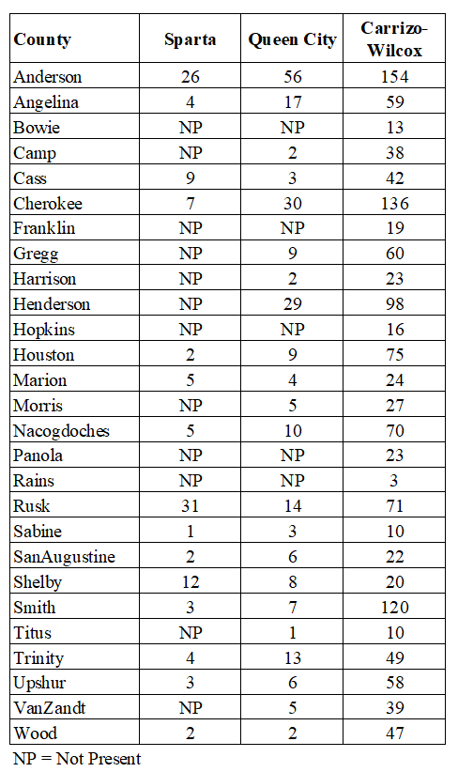
Proposed DFC
Scenario 26.2

Slide 13

Proposed DFC
Scenario 26.3

Slide 14
Proposed DFC
Scenario 26.3
NTVGCD Counties:
Scen 26.3 Drawdown
less than
Proposed DFC
(Neighboring counties pumping = Scenario 26.1)

Slide 15
Proposed DFC
Scenario 26.3
Nine non-NTVGCD Counties:
Scen 26.3 CW Drawdown
more than 5 ft greater than Proposed DFC
(NTVGCD pumping = Scenario 33)

Slide 16
Next Steps (1)
Similar to GMA 11 meeting on March 10, 2026, GMA 11 has two basic options for moving forward to adopt a “final” DFC:
  Choose one of the scenario presented in TM 26-03:
    Scenario 26.2 to 26.6
  Could direct me to develop a different scenario (further adjustments to pumping to achieve some objective)
    More pumping in a particular county or aquifer
    Less pumping in a particular county or aquifer
If one of the TM 26-03 scenarios is selected (i.e., 26.2 to 26.6):
  Results from selected scenario will be used to update the draft Explanatory Report
  GMA 11 would vote on a final DFC at next meeting (before January 5, 2027) and approve the explanatory report

Slide 17
Next Steps (2)
If GMA 11 requests a new scenario
  Budget increase = $6,000+$1,500 ($7,500)
    Updated GAM run with requested adjustments
    Prepare new draft Tech Memo documenting scenario results
    Additional meeting to adopt the new scenario as the basis for the DFC (November?)
  After approval at “November” meeting, update the draft Explanatory Report
    Updated Explanatory Report already in budget
  Meet again to approve DFC and updated explanatory report (before January 5, 2027)
    Budget increase for additional meeting ($1,500)

Slide 18
Budget Update
Budget table updated based on GMA 11 meeting on April 28, 2026:
  Approved Task 4a for five GAM simulations (TM 26-03)
    $10,000
New addition (assuming only one more GMA 11 meeting):
  Added Task 1a for one more meeting (final DFC vote and approval of Explanatory Report)
  Needs to be updated if there is more than one meeting
Invoice associated with this meeting = $2,875 per GCD
If GMA 11 selects one of the TM 26-03 scenarios as the basis for the final DFC today:
  Final invoice would cover one additional meeting and finalizing the Explanatory report: $2,875 per GCD
Need approval of new Task 1a for next meeting ($1,500)

Slide 19
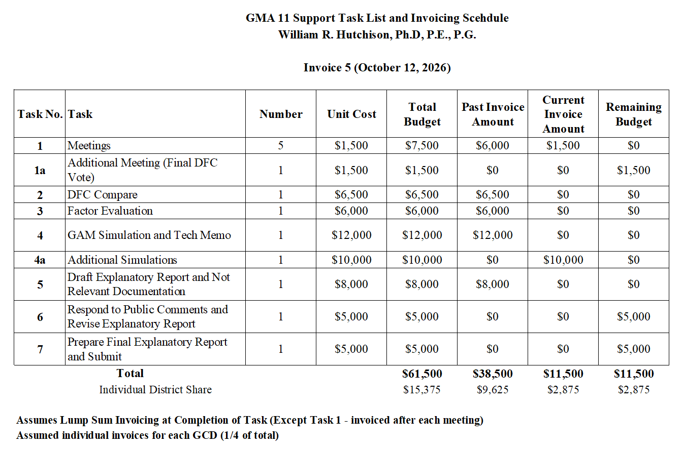

Slide 20
Questions?
William R. Hutchison, Ph.D., P.E., P.G.
billhutch@texasgw.com

