Slide 1
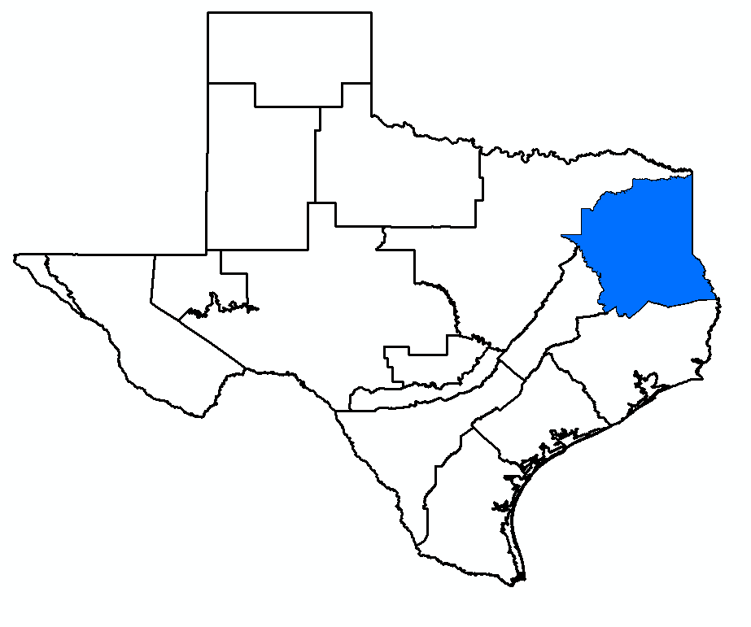
GMA 11 Joint Planning
Agenda Item 5:
Presentation of Draft Explanatory Report
William R. Hutchison, Ph.D., P.E., P.G.
GMA 11 Meeting
April 28, 2026

Slide 2
Overview
Two issues:
  Statutory deadline (May 1, 2026) for a proposed desired future condition (DFC)
  NTVGCD email of April 20, 2026 (concerns about Scenario 26.1)
If GMA 11 follows the statutory process:
  Deadline can be achieved
  NTVGCD’s concerns can be addressed
A GMA 11 vote today is on a proposed DFC
  90 public comment period follows
  Deadline to vote on DFC is January 5, 2027

Slide 3
Topics
Review of Joint Planning Process
Summary of Recent GMA 11 Meetings
Review of Draft Explanatory Report
Summary of NTVGCD issues
Options for next steps

Slide 4
Joint Planning Process
GMA 11 “proposes” desired future conditions (DFCs)
  Statutory deadline = May 1, 2026
90-day public comment period begins
  Each GCD writes a “District Summary Report” to GMA 11 coordinator summarizing comments and suggested changes to DFC
GMA 11 meets to review comments and suggested changes
GMA 11 votes on desired future condition (DFC)
  TWDB Administrative Rule deadline = January 5, 2027
GMA 11 coordinator submits DFC Explanatory Report and other required information (model files) to TWDB
TWDB issues a letter confirming “administrative completeness”
Each GCD in GMA 11 votes on the DFC relevant to their GCD
  Estimated time frame = mid-2027
GCD has two years from this GCD vote to update their management plan
Next Proposed DFC deadline = May 1, 2031

Slide 5
GMA 11 Meeting of October 14, 2025
Reviewed nine statutory factors for joint planning
Focused attention on reviewing 2021 DFC (Scenario 33) in the context of dry wells and surface water-groundwater interactions
Public comments at that meeting included:
  DFCs should focus on aquifer limits
  De-emphasize state water plan needs
  Surface water impacts should be addressed
GMA 11 directed me to complete additional simulations to address concerns
  Draft Technical Memorandum 26-02 (February 26, 2026)

Slide 6
GMA 11 Meeting of March 10, 2026
Reviewed results of four scenarios (out of nearly 20 completed)
  Baseline, Scenario 33, Scenario QC1, Scenario 26.1
At end of review, slides 48 and 49 outlined two possible next steps
  Choose one of the scenarios presented as the basis for a DFC and prepare a draft explanatory report
  Direct me to develop a different scenario
    Further adjustments to pumping to achieve some objective (more pumping in a particular county or relax dry well threshold used in Scenario 26.1)
Action taken to select Scenario 26.1 as basis for proposed DFC and directed me to prepare a draft explanatory report
  Released on April 9, 2026

Slide 7
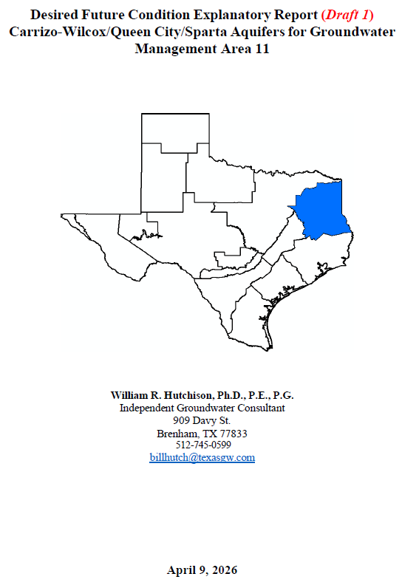
Draft Explanatory Report
Follows outline of TWDB checklist
  Facilitates TWDB review for administrative completeness
This draft is not a joint planning requirement
  Not required until final submittal to TWDB
Draft is intended to provide information during 90-day public comment period required in statute after the GMA 11 vote on a proposed DFC
  Current process already provides a means to make changes to a proposed DFC prior to finalizing the DFC

Slide 8
Outline of Draft Explanatory Report
Groundwater Management Area 11
Desired Future Condition History in GMA 11
2026 Desired Future Conditions
Policy Justification
Technical Justification
Factor Consideration
Discussion of Other Desired Future Condition Considered
Discussion of Other Recommendations (to be completed after public comment)
References

Slide 9
Summary of NTVGCD Issues
Email of April 20, 2026
  MAG reduction is “not acceptable”
    De-emphasizes regional water supply
    Emphasizes avoidance of dry wells
    Emphasizes surface water-groundwater interaction metrics
  Resulting MAG values are “inconsistent” with Region D and Region I water plans
  “Dry well threshold was applied without sufficient analysis of alternative scenarios that could achieve similar sustainability goals”
Note: No mention of drawdown (DFC), groundwater conditions, aquifer limits

Slide 10
Summary of NTVGCD Issues
Email of April 20, 2026
  MAG reduction is “not acceptable”
    De-emphasizes regional water supply
    Emphasizes avoidance of dry wells
    Emphasizes surface water-groundwater interaction metrics
  Resulting MAG values are “inconsistent” with Region D and Region I water plans
  “Dry well threshold was applied without sufficient analysis of alternative scenarios that could achieve similar sustainability goals”
Note: No mention of drawdown (DFC), groundwater conditions, aquifer limits

Slide 11
Alternative Scenarios
Developing alternative scenarios to satisfy NTVGCD’s concerns can be accomplished under the joint planning process

Slide 12
During Upcoming Public Comment Period
NTVGCD’s issues can be addressed with additional simulations
  As originally discussed at GMA 11 meeting on March 10, 2026
Recommend a series of simulations with increased pumping in selected counties
  Update dry well impacts and surface water impacts for each alternative pumping scenario
  Compare and “balance” higher pumping with dry wells and surface water impacts
    Best use of model results: comparison of alternative scenarios
  Identify a simulation that satisfies NTVGCD concerns

Slide 13
Proposed Scope, Budget, and Schedule
Five simulations and documentation (Technical Memorandum)
  Proposed budget increase = $10,000
  Completed by July 1, 2026
GMA 11 would meet in Fall 2026 to discuss all public comments and review updated simulation
Please note that this approach avoids “missing the deadline” for a proposed DFC (May 1, 2026)
  Rep. Harris and TWDB have stated that there are “no penalties” for missing deadline (emails of April 23, 2026)
  Missing a statutory deadline could result in unforeseen consequences

Slide 14
Two Basic Options Available to GMA 11
Option 1:
  No vote today on Proposed DFC (miss statutory deadline)
  Complete additional work to find an acceptable alternative to address NTVGCD concerns
  Vote on Proposed DFC at a future date once NTVGCD is satisfied
  Proceed to public comment period and final vote
    Timing to meet January 2027 deadline?
Option 2:
  Vote to “propose” DFCs associated with Scenario 26.1
    Does not need to be unanimous (2/3 of GCDs) to “propose”
  Complete additional simulations during 90-day public comment period
  Make appropriate changes to satisfy NTVGCD concerns
    Address any other public comments received
  Final vote on DFC at GMA 11 meeting in Fall 2026
    Meet final DFC deadline: January 5, 2027
Note: Last week, GMA 13 voted on proposed DFCs that will be modified during the public comment period

Slide 15
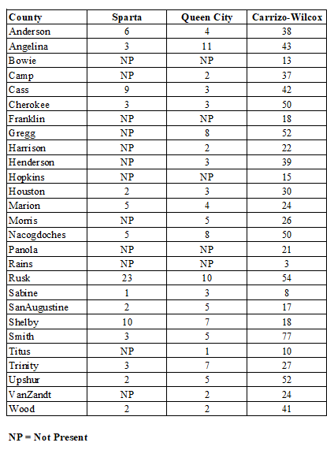
Proposed DFCs associated with
Scenario 26.1
Average Drawdown by
County (2013 to 2080)
Table 1 of Draft Explanatory Report
(page 10, pdf page 11)

Slide 16
Other Tables from Draft Explanatory Report

Slide 17
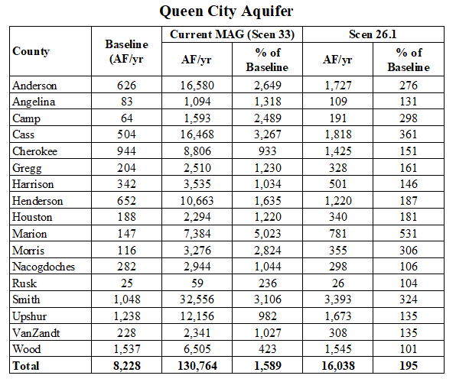
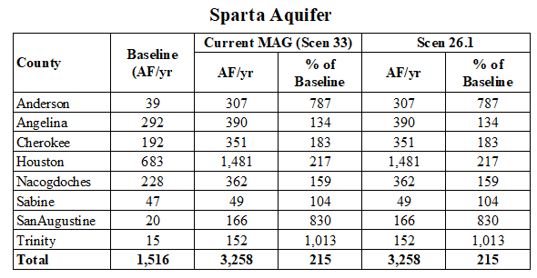
Pumping (Expected MAGs)
Tables 2 and 3 of Draft Explanatory Report
(page 17, pdf page 18)

Slide 18
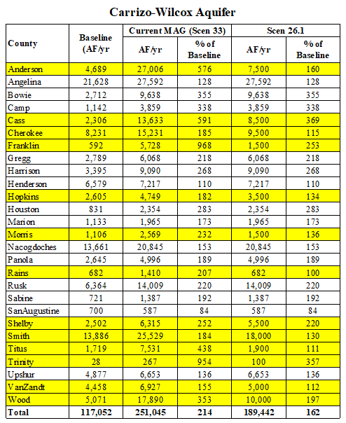
Pumping (Expected MAGs)
Table 4 of Draft Explanatory Report
(page 18, pdf page 19)

Slide 19
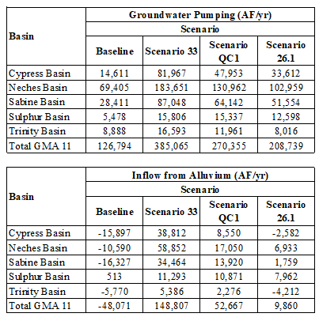
Groundwater
Pumping and
Inflow from Alluvium
Table 6 of Draft Explanatory Report
(page 21, pdf page 22)

Slide 20
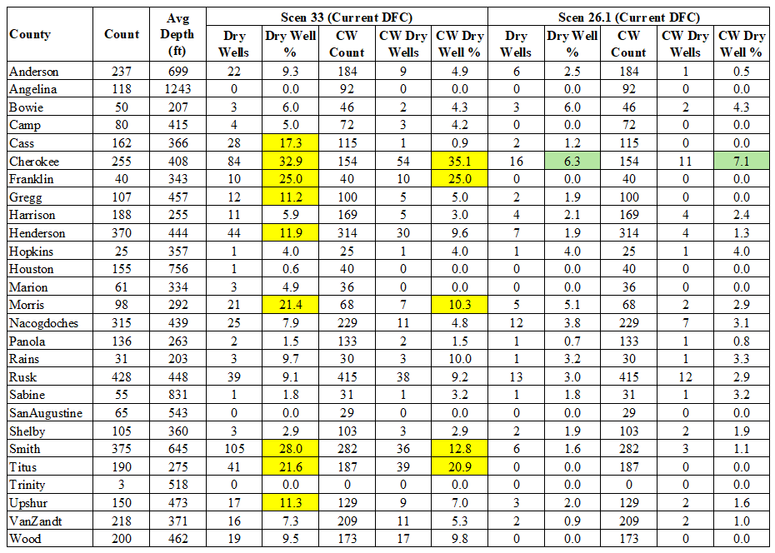
Dry Well
Analysis
Table 8 of Draft Explanatory Report
(page 25, pdf page 26)

