Slide 1
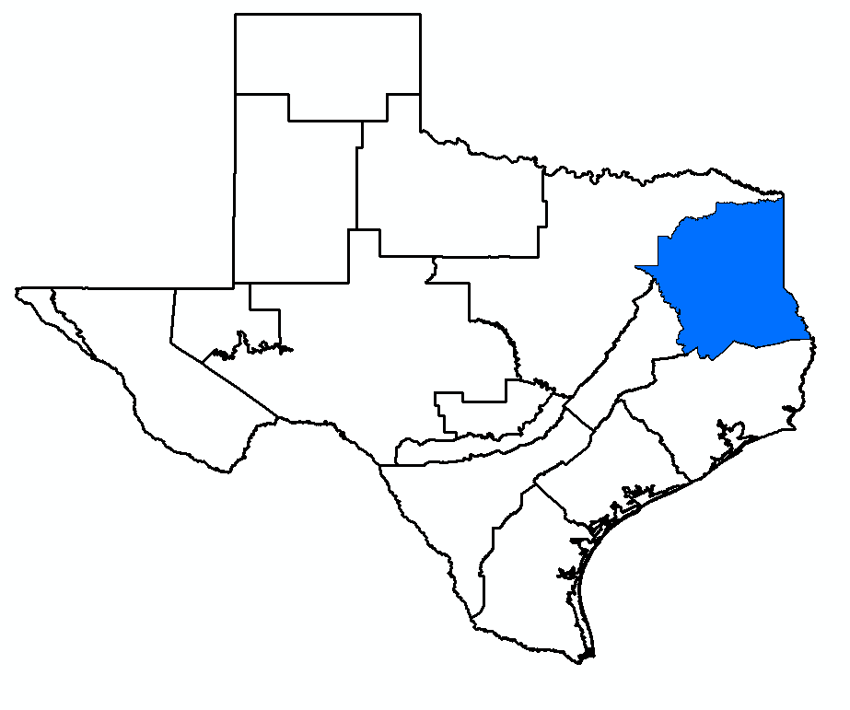
GMA 11 Joint Planning
Updated Pumping Scenarios
(Agenda Item 3)
William R. Hutchison, Ph.D., P.E., P.G.
GMA 11 Meeting
March 10, 2026

Slide 2
Topics
Sustainable Yield Review
Results of updated pumping simulations (Tech Memo 26-02)
  Dry well analysis
  Surface water impacts
  Induced interbasin flow
  Average drawdown
Next steps
  Proposed DFC deadline is May 1, 2026

Slide 3
Sustainable Yield
Definition: the amount of water that can be pumped from an aquifer over a specified period without causing negative or undesirable effects
  Undesirable effects can be hydrogeologic, environmental, or economic
From a joint planning perspective, task is to quantify, analyze, and balance “predicted” decline with other alternative scenarios (what is an “acceptable” decline?)
Simulations presented in Tech Memo 26-02 provide a method to define “undesirable” effects
  Dry wells
  Surface water impacts of increased pumping)

Slide 4
Sustainable Yield
Definition: the amount of water that can be pumped from an aquifer over a specified period without causing negative or undesirable effects
  Undesirable effects can be hydrogeologic, environmental, or economic
From a joint planning perspective, task is to quantify, analyze, and balance “predicted” decline with other alternative scenarios (what is an “acceptable” decline?)
Simulations presented in Tech Memo 26-02 provide a method to define “undesirable” effects
  Dry wells
  Surface water impacts of increased pumping)

Slide 5
House Natural Committee Meeting (2/10/2026)
Sustainability concepts and definitions are not consistent:
  What is the maximum amount of groundwater can be produced annually in perpetuity?
    MAG should be a cap
  TERS should be replaced with “maximum sustainable production”
  95% of current DFCs are “unsustainable”
    Exaggeration based on different standard and definition

Slide 6
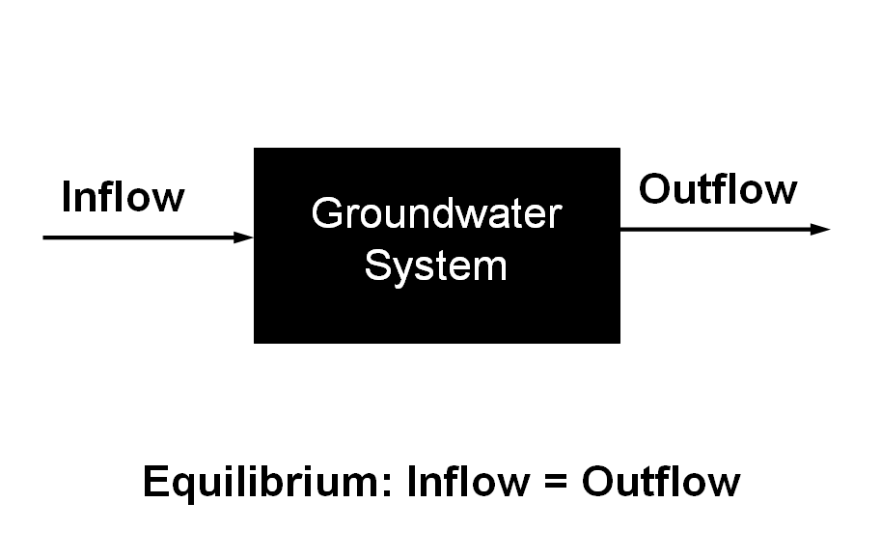
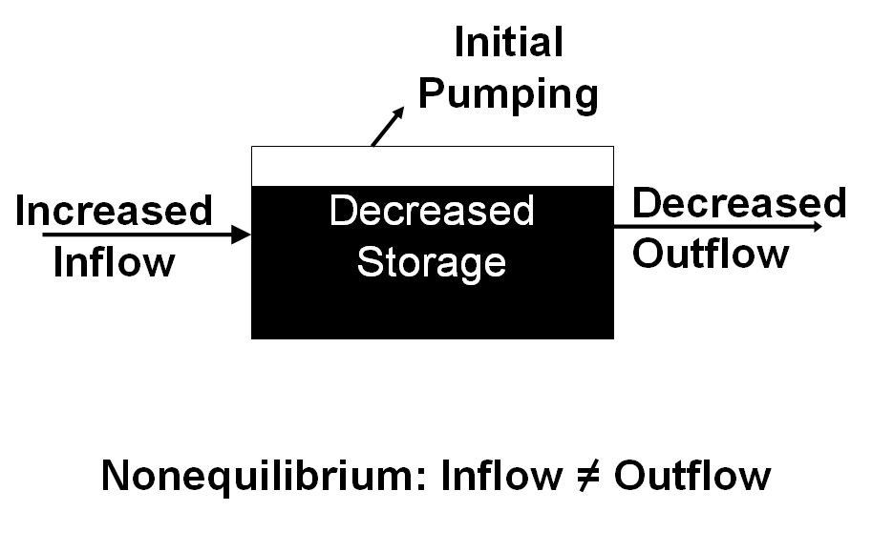
Hutchison (2006) modified from Alley and others (1999)

Slide 7
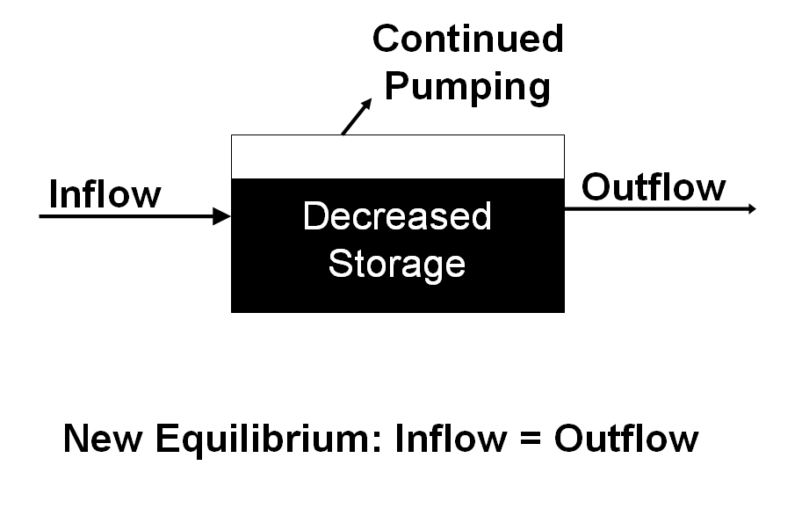
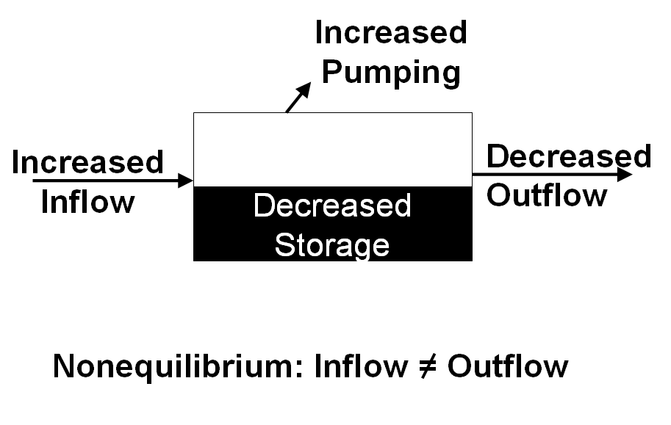
Hutchison (2006) modified from Alley and others (1999)

Slide 8
Time to reach equilibrium = ????
Hutchison (2006) modified from Alley and others (1999)

Slide 9
GMA 11 Application
Current DFC is a “maximum sustainable production”
  Resulted in dry wells and surface impacts that are “unacceptable”
Two specific metrics to evaluate “sustainability” or “sustainable yield” (discussed at GMA 11 meeting in October 2025):
  Impacts to streamflow
  Quantifying number of “dry wells”
Simulations completed in response to October 2025 meeting were designed to focus on reducing “undesirable impacts”
GMA 11 has focused on adopted a DFC that recognizes aquifer limits
  Tech Memo 26-02 analyzes reductions in “maximum sustainable pumping” to address “unacceptable impacts”

Slide 10
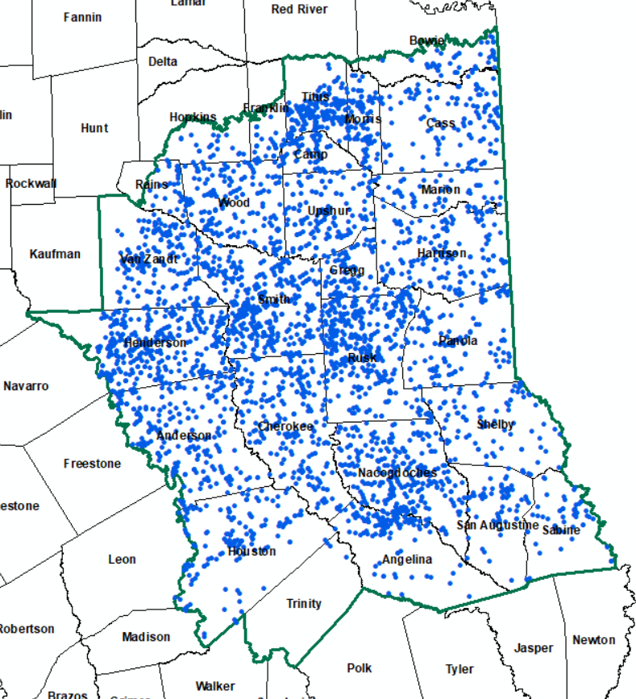
Well Locations in GMA 11
TWDB Database (Well Locations and Depths)
5,786 wells in GMA 11
4,217 wells with good depths (depicted on map)

Slide 11
GMA 11 Meeting of October 14, 2025
Evaluated 4,217 wells in GMA 11
Compared simulated groundwater levels from Scenario 33 (basis for current DFC) in 2080 with well bottom elevation
  20 feet higher than well bottom
515 wells would “go dry”
  Revised from 568 with updated GAM
Updated simulations recommended to assess reductions in dry wells

Slide 12
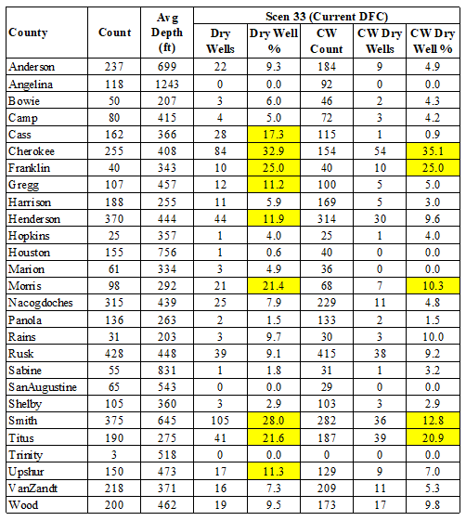
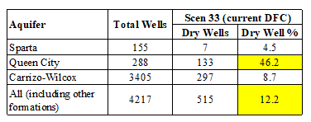

Slide 13
Updated Pumping Scenarios
GMA 11 meeting of October 14, 2025
  Summarized dry well analysis
  Summarized surface water impact analysis
Recommended a series of simulations to reduce impacts to wells and surface water
  Reduced Queen City pumping (QC)
  Reduced Carrizo-Wilcox pumping (CW)
Summarize results
  Dry well analysis
  Surface water impact analysis (by river basin)
Documented in Tech Memo 26-01

Slide 14
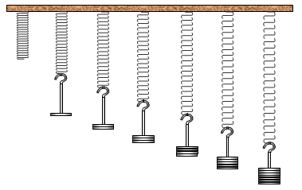
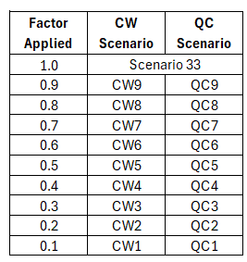
Summary of CW and
QC Scenarios
Pumping factors applied to Queen City and Carrizo-Wilcox (individually)
  Reductions applied cell-by-cell
  Cell minimum = 2013 cell pumping
Also completed:
  Scenario 33 from 2021 (basis for current DFC) with updated specific yield values
  Baseline (2013 pumping through 2080)

Slide 15
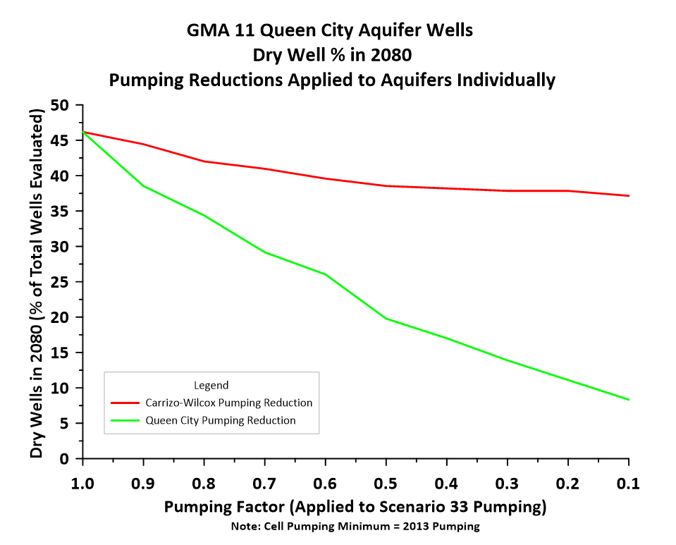

Slide 16
Scen CW1

Slide 17
Scen QC1

Slide 18
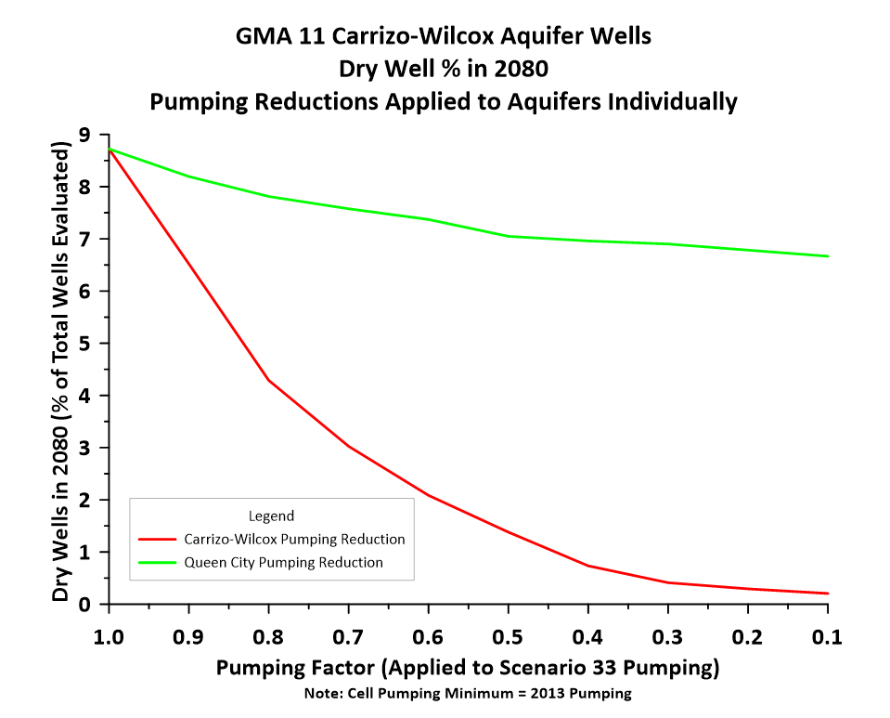

Slide 19
Scen CW1

Slide 20
Scen QC1

Slide 21
Summary of CW and QC Scenarios
Pumping reductions result in fewer dry wells
  Reductions in Queen City pumping have the most benefit
Vertical connection evident
  Reductions in Queen City pumping results in fewer dry wells in Carrizo-Wilcox Aquifer
  Reductions in Carrizo-Wilcox pumping results in fewer dry wells in Queen City Aquifer
90% reduction in Scenario 33 pumping in Queen City Aquifer still represents a large increase in historic pumping (2013 or 2023)

Slide 22
Scenario 26.1
Developed based on first 20 simulations
  CW and QC scenarios were “global” pumping reductions
  Identified counties with more than 10% dry wells
Identified targeted pumping reductions
  Objective = no county with more than 10% dry wells (overall and Carrizo-Wilcox Aquifer)
    Limiting dry wells to 10% is an example of avoiding an “undesirable impact”
Pumping Comparisons by Aquifer
  Baseline (2018 pumping)
  Scen 33 (Current DFC/MAG)
  Scen 26.1

Slide 23
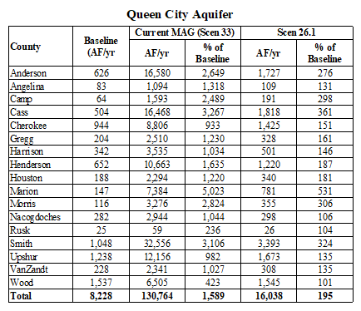
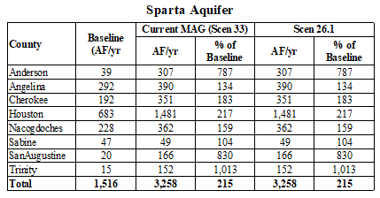
Scenario 26.1 Pumping

Slide 24
Scenario 26.1 Pumping
Scen 26.1 Sparta Aquifer Pumping
No Change in Sparta Compared to Scen 33
Small AF increase from baseline
Large % increase from baseline

Slide 25
Scenario 26.1 Pumping
Scen 26.1 Queen City Aquifer Pumping
Increase compared to baseline
Large decrease compared Scen 33

Slide 26
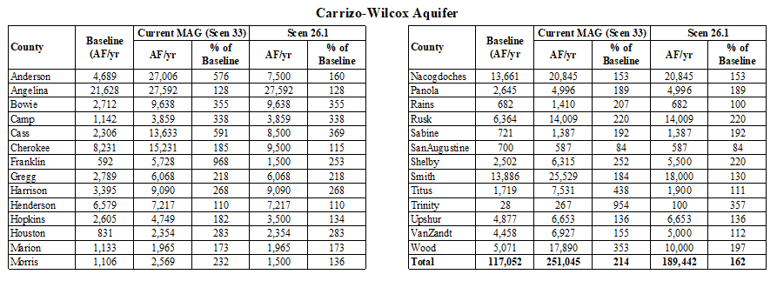
Scenario 26.1 Pumping

Slide 27
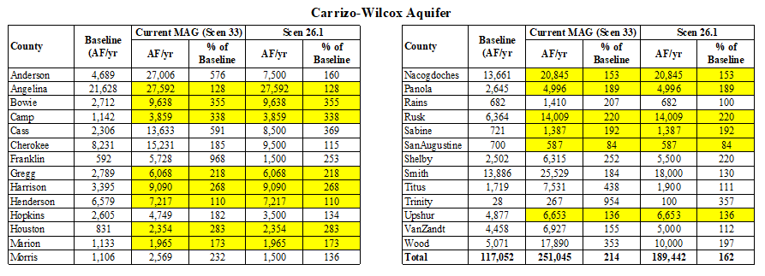
Scenario 26.1 Pumping – Counties with No Change from Current MAG

Slide 28
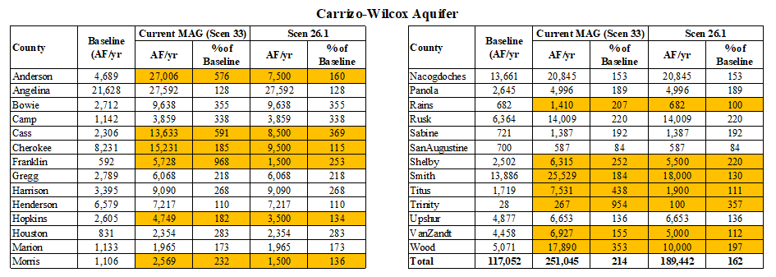
Scenario 26.1 Pumping – Counties with Reductions from Current MAG

Slide 29
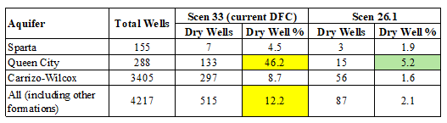
Scenario 26.1 Results – Dry Well Analysis
Results organized by:
  Aquifer
  County

Slide 30
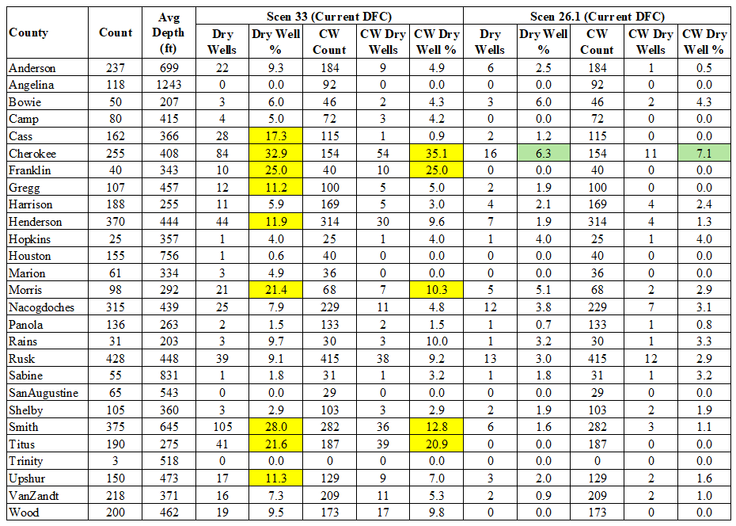
Scenario 26.1 Results:
Dry Well Analysis by County

Slide 31
Scenario 26.1 - Surface Water Impacts
Groundwater budget analysis for each scenario completed by river basin in GMA 11
  Cypress
  Neches
  Sabine
  Sulphur
  Trinity
Assess general character of streams in each basin (gaining or losing)
Detailed results in Tech Memo 26-02
  Summaries of surface water-groundwater interaction by basin presented today

Slide 32
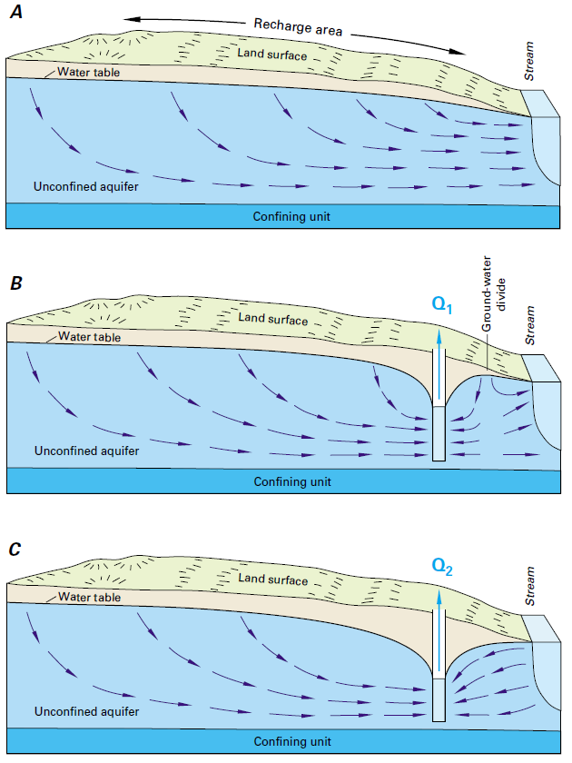
No Pumping Condition
After Initial Pumping
After Prolonged Pumping
From Alley and others (1999)

Slide 33
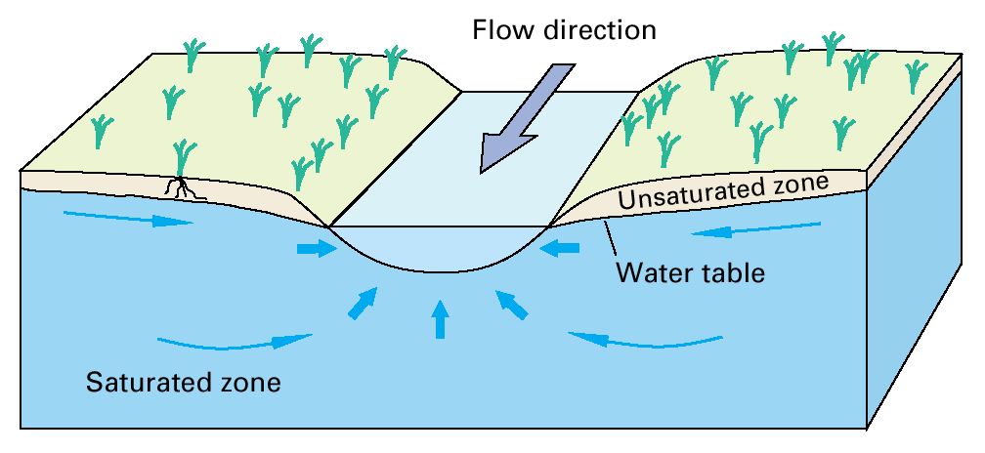
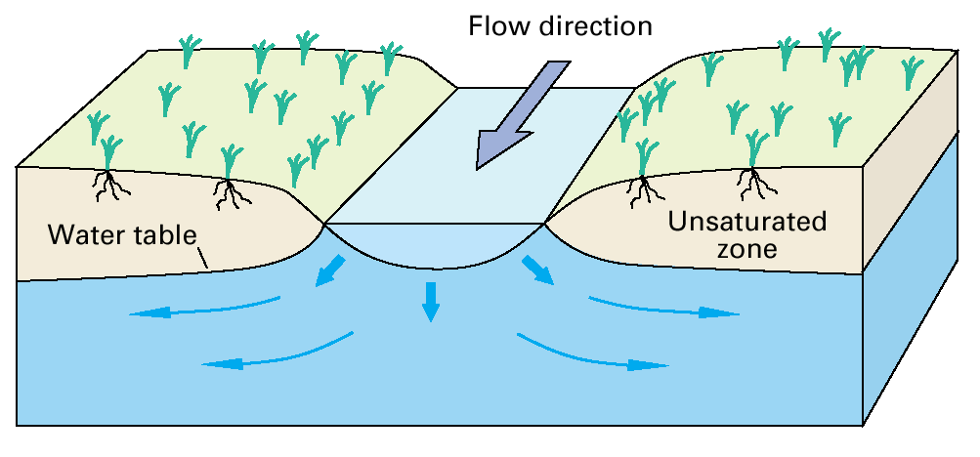
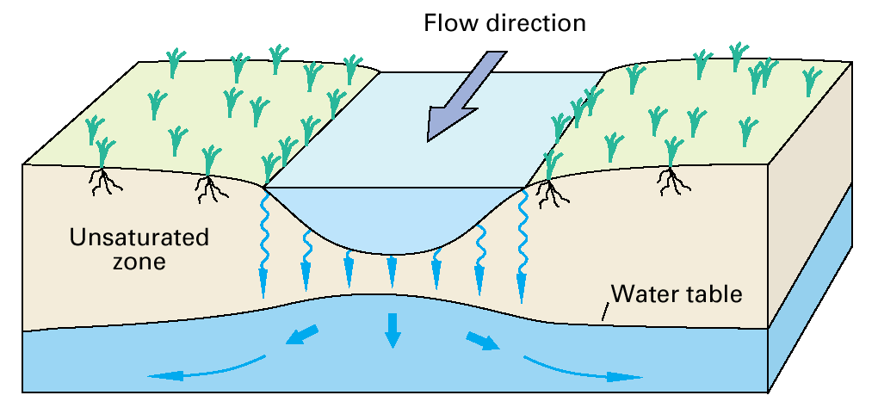
Gaining Stream
Losing Stream
Disconnected Stream
From Winter and others (1998)

Slide 34
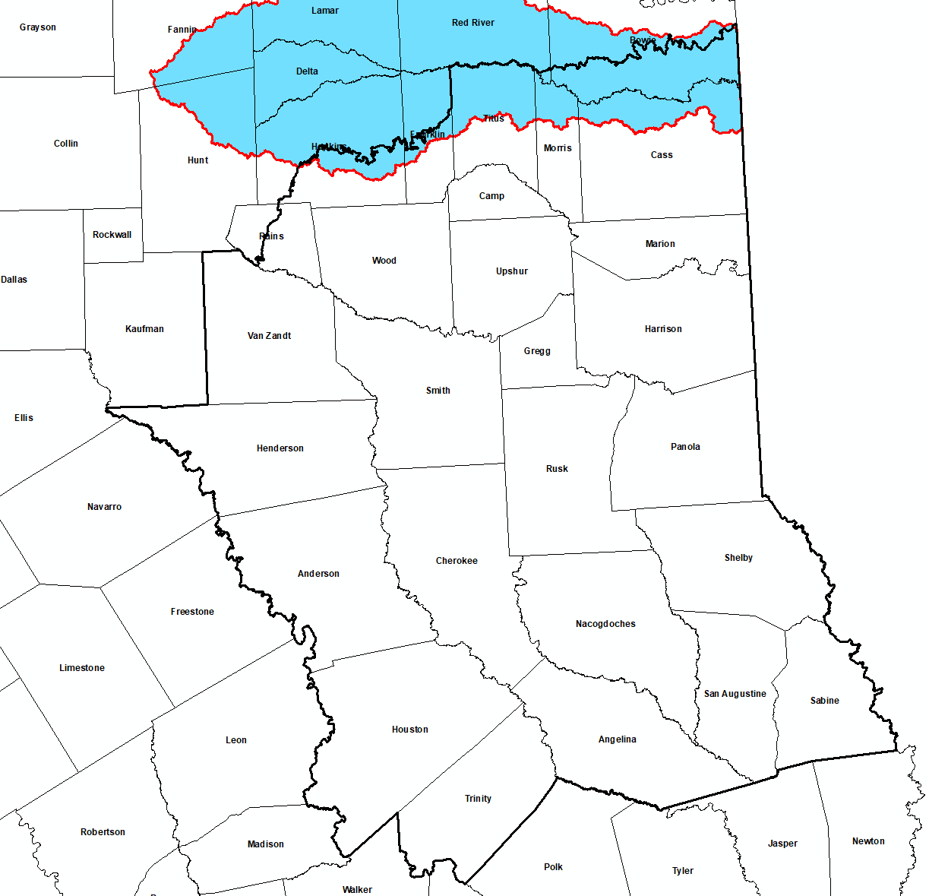
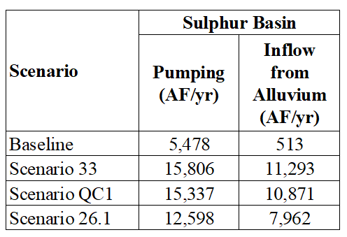
Sulphur

Slide 35
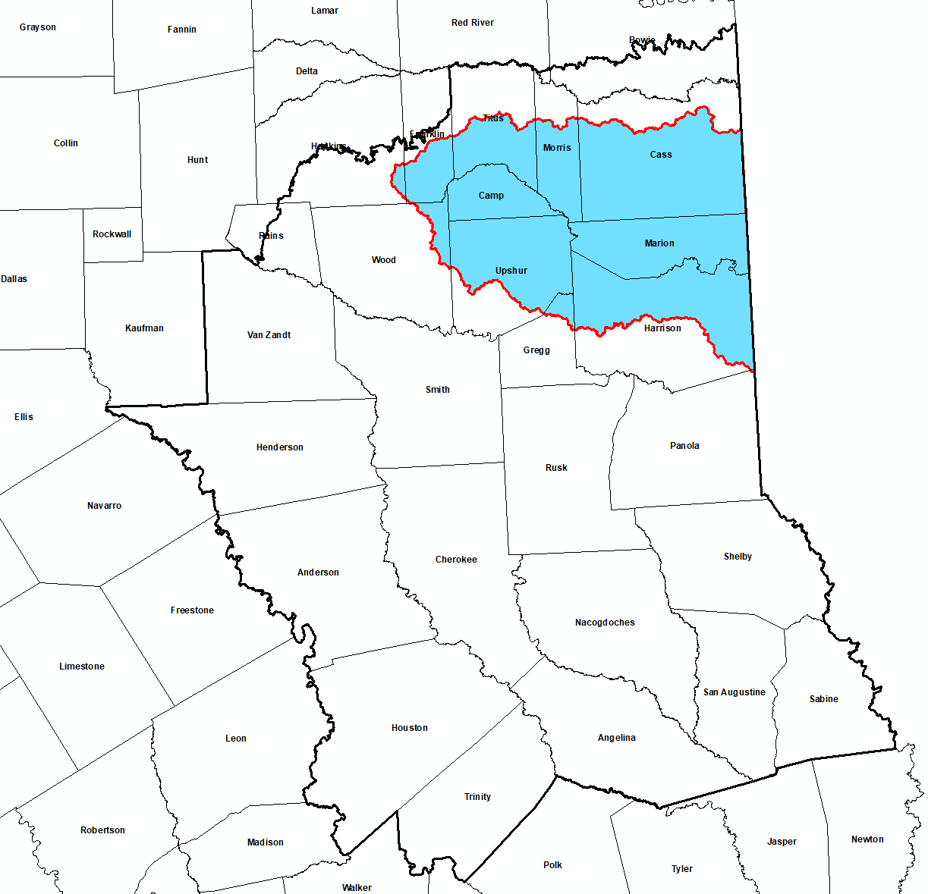
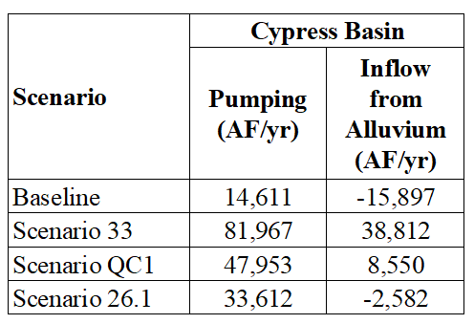
Cypress
Note:
Negative Inflow from Alluvium =
Groundwater flow into stream
(net gaining stream condition)

Slide 36
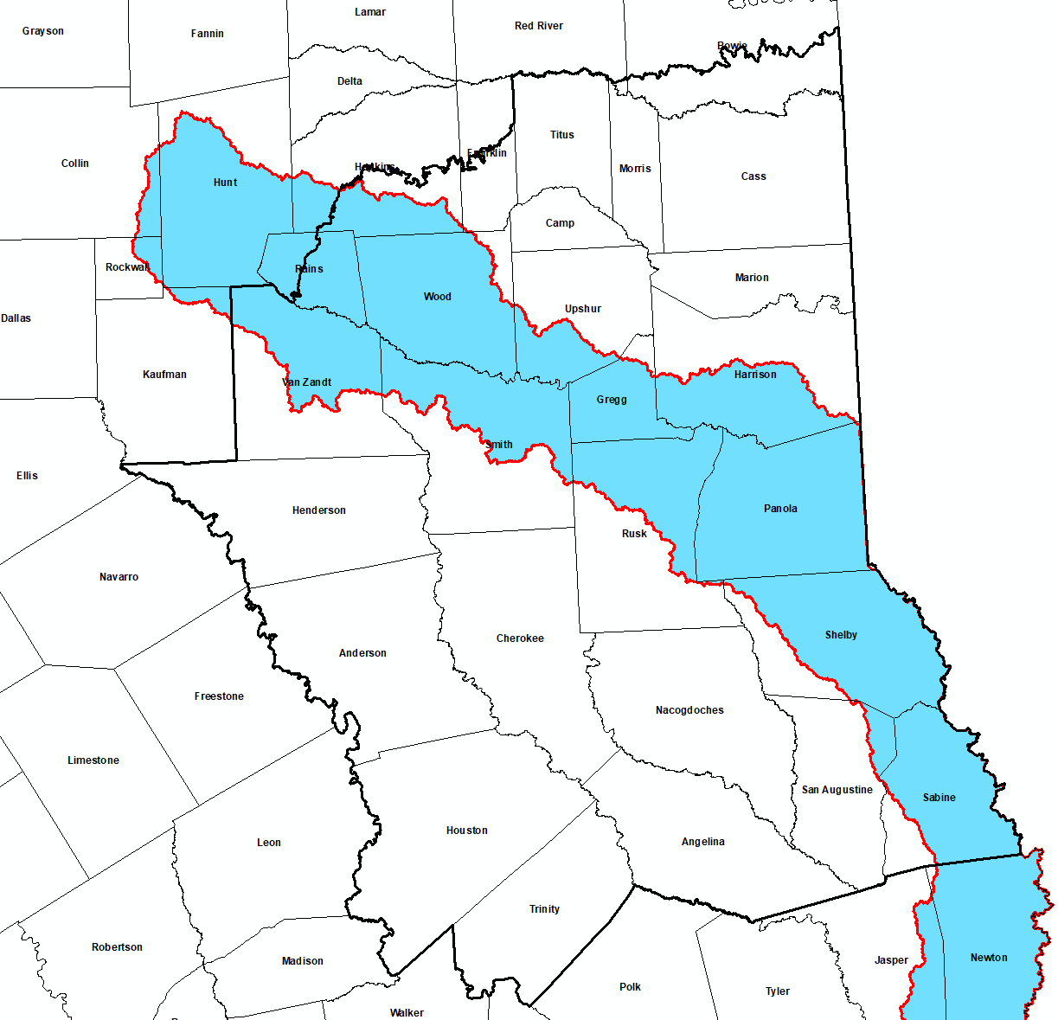
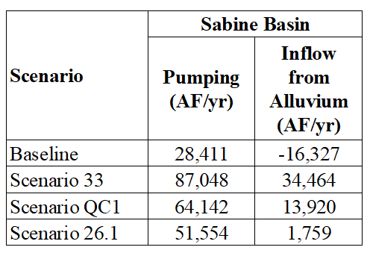
Note:
Negative Inflow from Alluvium =
Groundwater flow into stream
(net gaining stream condition)
Sabine

Slide 37
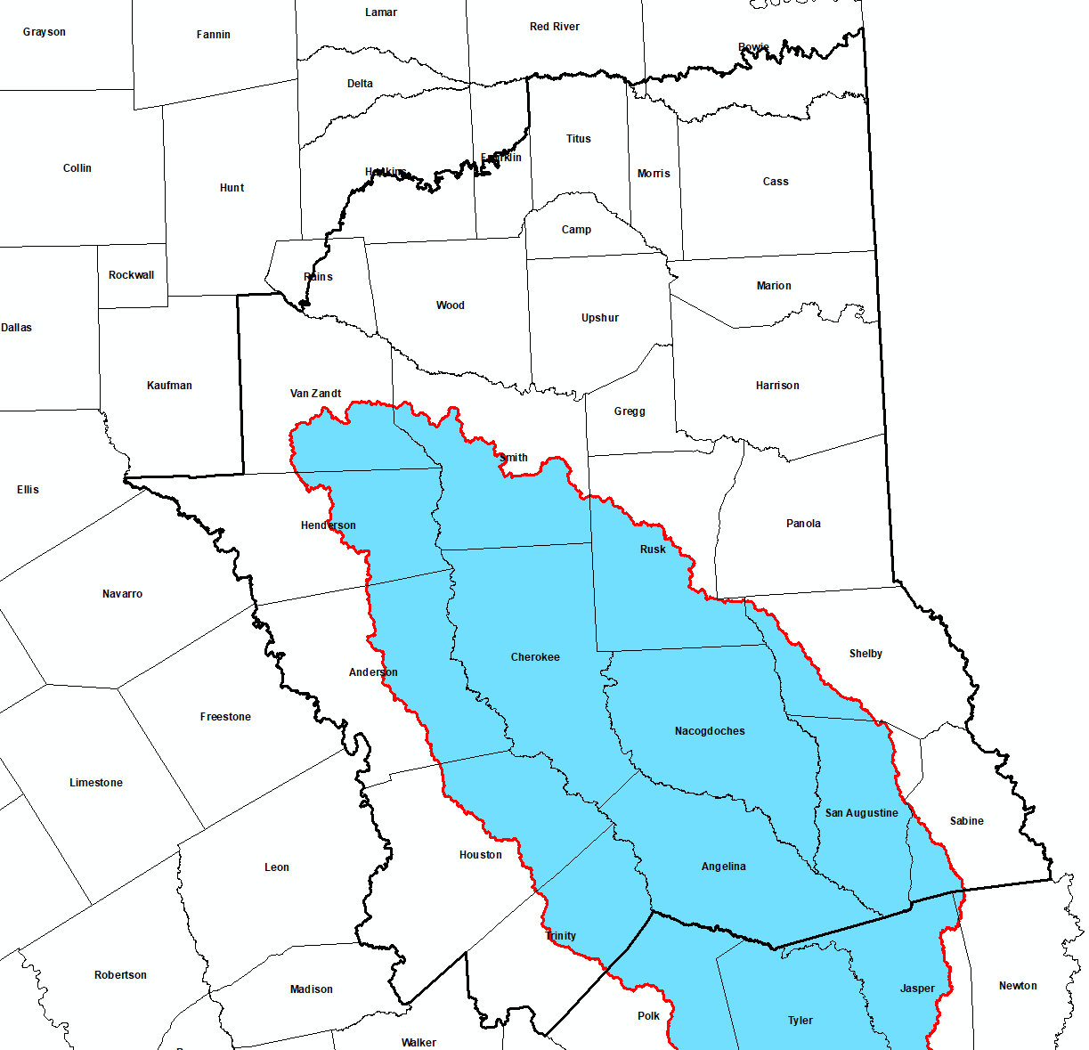

Neches
Note:
Negative Inflow from Alluvium =
Groundwater flow into stream
(net gaining stream condition)

Slide 38
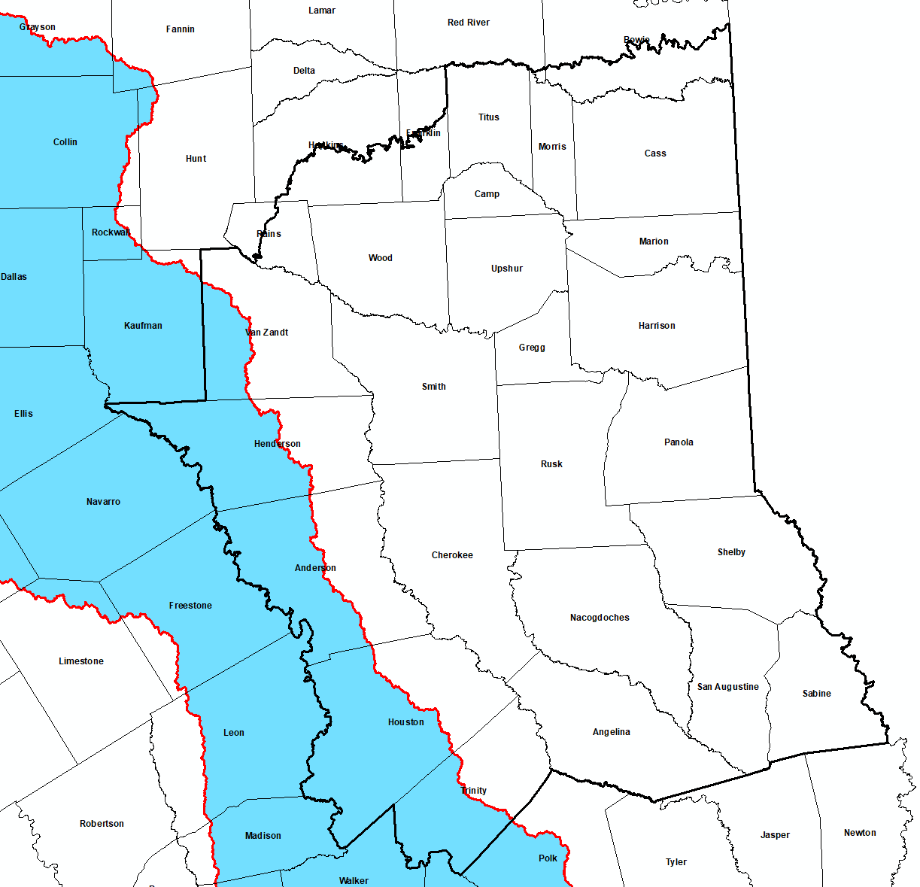
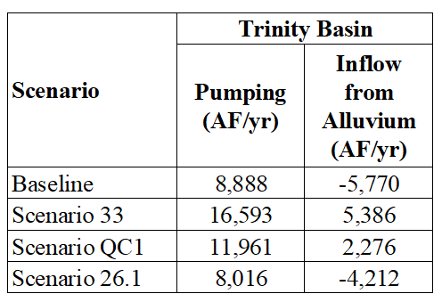
Trinity
Note:
Negative Inflow from Alluvium =
Groundwater flow into stream
(net gaining stream condition)

Slide 39
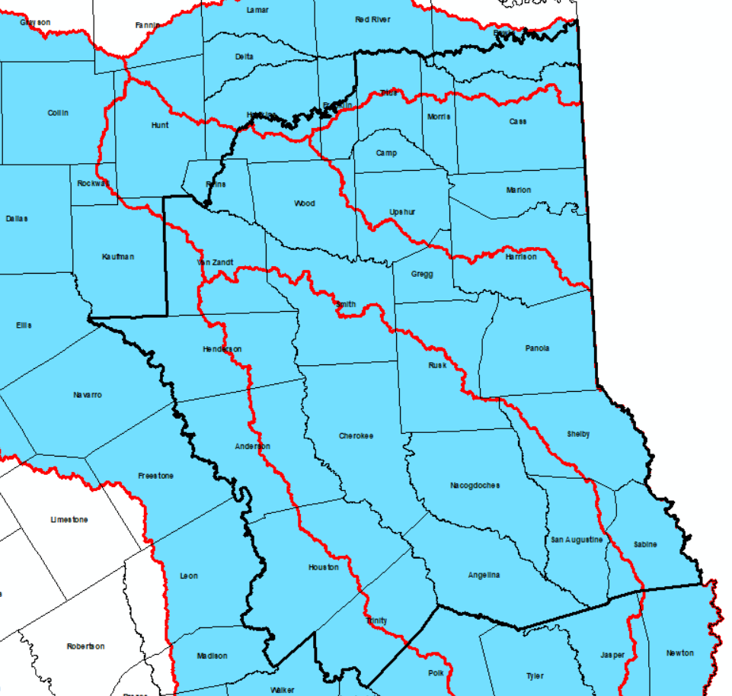
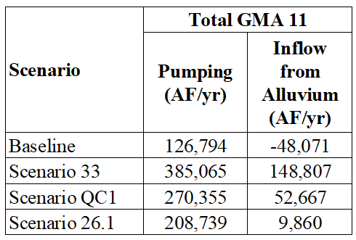
GMA 11
Note:
Negative Inflow from Alluvium =
Groundwater flow into stream
(net gaining stream condition)

Slide 40
Basin Groundwater Budgets
Pumping varies by basin
  Basin pumping as a percentage of GMA 11 pumping (for each scenario)
    Sulphur Basin: 4 to 6 percent
    Cypress Basin: 12 to 21 percent
    Sabine Basin: 22 to 25 percent
    Neches Basin: 48 to 55 percent
    Trinity Basin: 4 to 7 percent
Quantified interbasin flow induced by increased pumping

Slide 41
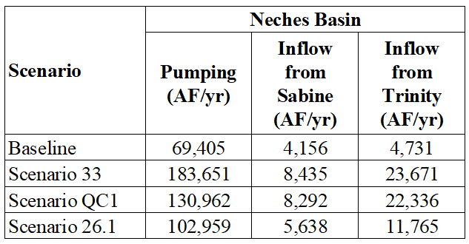
Induced Interbasin Flow
Discussed in more detail in Tech Memo 26-02
Example: Neches Basin (highest pumping)

Slide 42
Decadal Drawdowns - Scenario 26.1
(Required by HB 2078)
GMA 11 has historically chosen to articulate DFCs as average drawdown by county and aquifer at end of period
  DFC in 2021 used 2080 as the end of the planning period
HB 2078 now requires to also include “intermediate” (decadal) values
Comparison with current DFCs
  Carrizo-Wilcox Aquifer

Slide 43
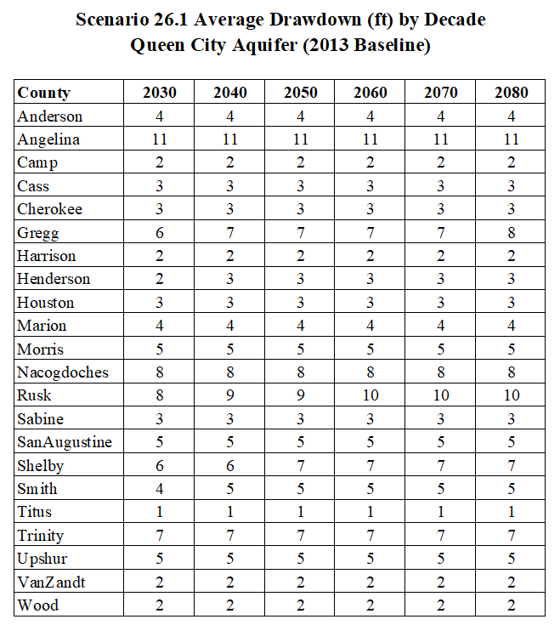
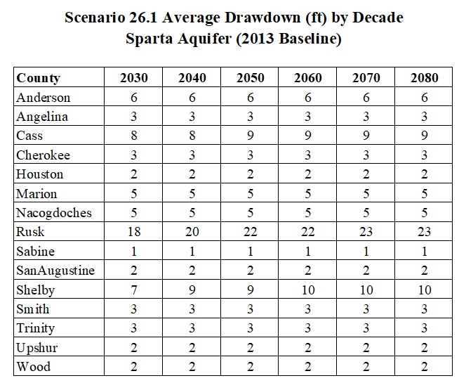

Slide 44
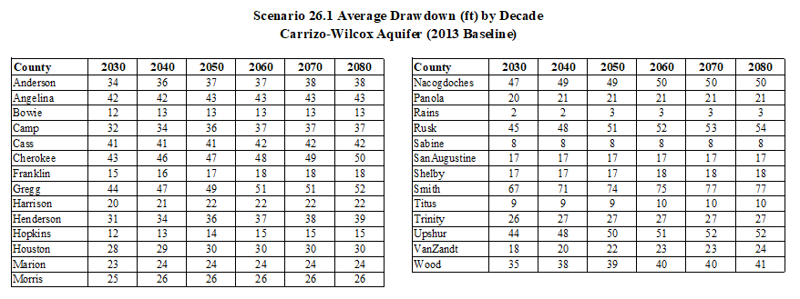

Slide 45
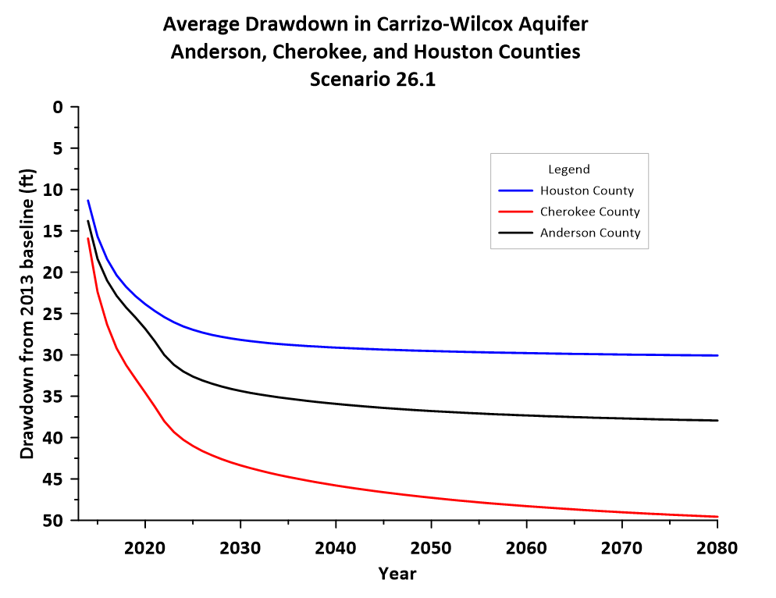

Slide 46
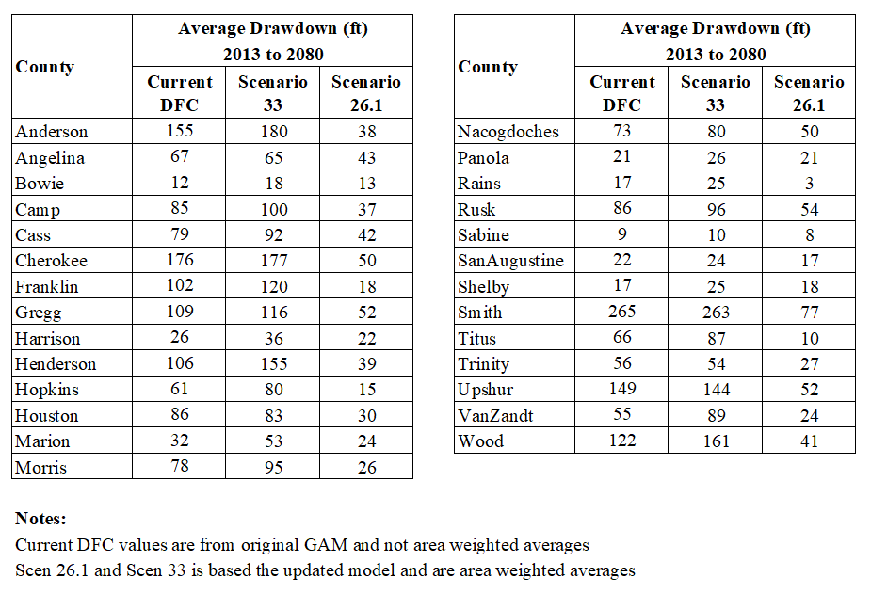
Carrizo-Wilcox Aquifer
Compare 2080 Drawdowns

Slide 47
Joint Planning and GAM Accuracy
(Anticipated Comments)
“The GAM is inaccurate and cannot be used to make these type of decisions”
  All model can be improved
  Recommendations will be made to improve current model in explanatory report
    TWDB has historically been receptive to updating models in response to GMA comments
  Joint planning extends to 2080, but updated every five years
    An improved model will better inform 2031 joint planning cycle
    Increased public participation will improve defining “unacceptable impacts”
    Joint planning is an example of “Adaptive Management”
      Incorporates new data and models into decision-making

Slide 48
Next Steps (1)
GMA 11 decides on proposed DFC
  Could choose one of the scenarios presented to advance as basis for proposed DFC:
    Baseline
    Scenario 33 (basis for 2021 DFC)
    Scenario QC1
    Scenario 26.1
  Could direct me to develop a different scenario (further adjustments to pumping to achieve some objective)
    Examples of objectives:
      More pumping in a particular county
      Relax dry well standard of Scenario 26.1 (10%) resulting in higher pumping
If an existing scenario is chosen (e.g. Scenario 26.1):
  I will prepare draft Explanatory Report
    Draft available before next meeting
  GMA 11 would vote on a proposed DFC at next meeting

Slide 49
Next Steps (2)
If requested to develop a new scenario
  Make requested adjustments
  Prepare new draft Tech Memo documenting scenario results
  Budget increase = $6,000
  Decide whether to meet to approve advancing new scenario to be basis for proposed DFC
    Additional meeting would require a budget increase of $1,500
  Prepare a draft Explanatory Report
  GMA 11 would vote on a proposed DFC prior to May 1, 2026

Slide 50
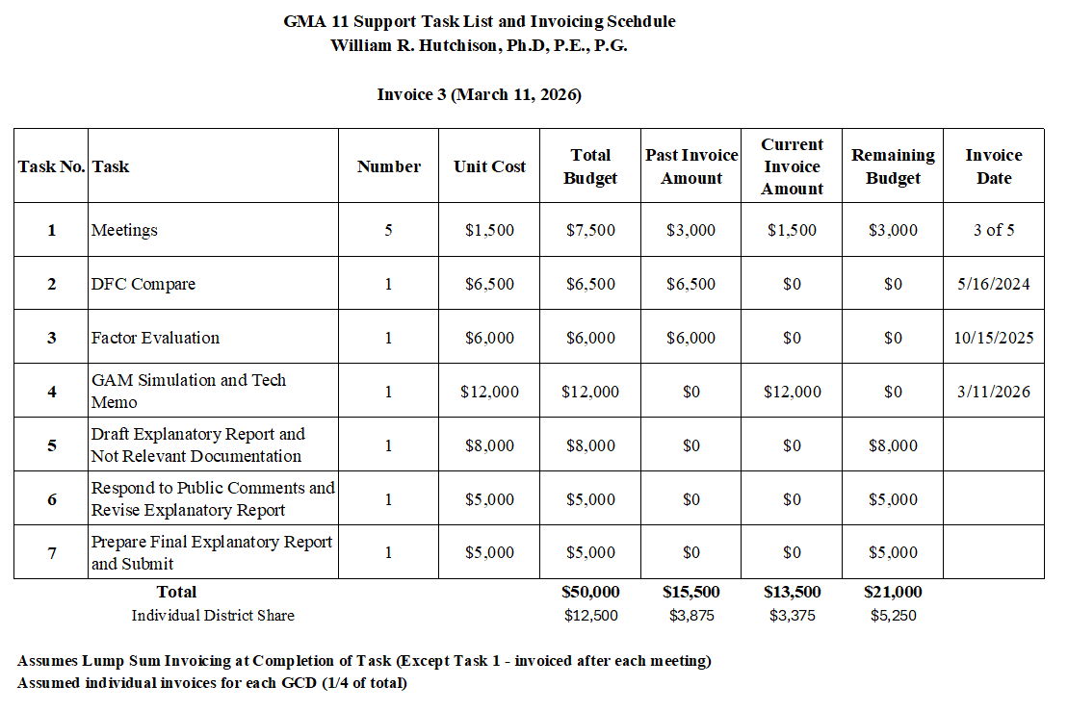
Budget and Invoicing Update

Slide 51
Resolution to Submit Minor Update of GAM to TWDB
(Agenda Item 7)
William R. Hutchison, Ph.D., P.E., P.G.
GMA 11 Meeting
March 10, 2026

Slide 52
Specific Yield Issues
Specific yield values in model needed to be modified
Issue was known in 2021 and 2022
  Analyses completed at the time (for the GMA 13 GAM update) demonstrated that these updates would not significantly affect results
Issue was discussed during a meeting with TWDB and TRA on December 15, 2025
Documentation in Technical Memorandum 26-01
In summary:
  Alluvium = 0.1 (updated)
  Bedrock Aquifers = 7.14 E-04 (unchanged)
No significant change in calibration statistics
Summary comparison of dry well analysis presented at GMA 11 meeting of October 14, 2025

Slide 53
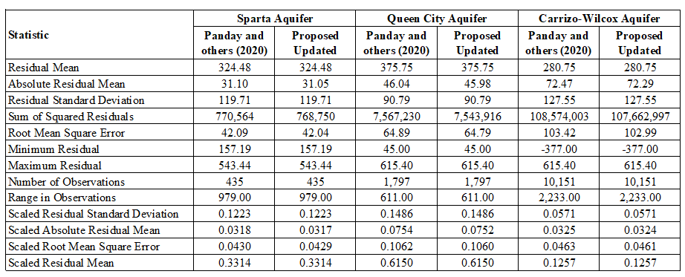

Slide 54
TWDB Standard < 0.10

Slide 55
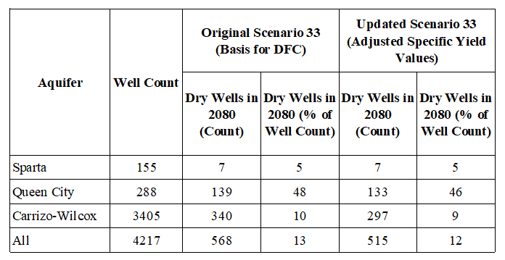
Comparison of Dry Well Analysis with Updated Specific Yield Values in GAM

