Slide 1
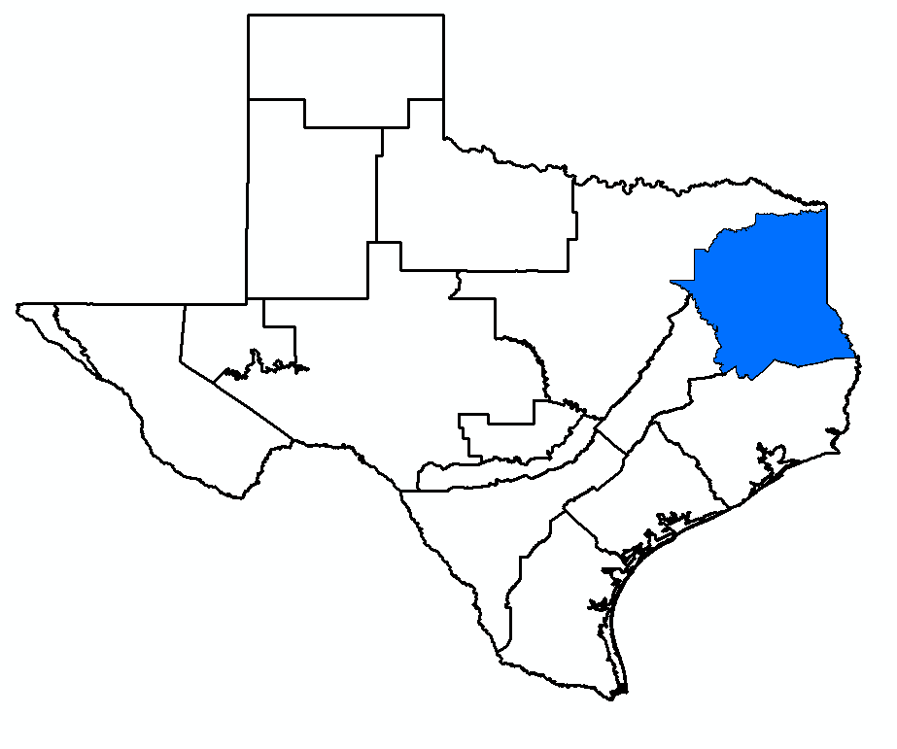
GMA 11 Joint Planning
Rounds 1 to 3 (History)
Round 4 (Current Round)
William R. Hutchison, Ph.D., P.E., P.G.
GMA 11 Meeting
October 14, 2025

Slide 2
Introduction
Involved with Joint Planning Process since 2009
  2010 Joint Planning
    TWDB Director of Groundwater Resources Division (2009 to 2011)
    Provided technical assistance to all 15 GMAs (lead in 9)
  2016 Joint Planning
    Consultant for 6 GMAs (2, 3, 4, 7, 11 and 13)
  2021 Joint Planning
    Consultant for 5 GMAs (2, 3, 4, 7, and 11)
  Current Round of Joint Planning
    Consultant for 5 GMAs (2, 3, 7, 11, and 13)
Expert Witness for Texas (Texas v. New Mexico and Colorado) since 2012
  Key technical issue: impacts of groundwater pumping on streamflow

Slide 3
Objectives for Today
Statutory deadline for Proposed Desired Future Condition (DFC)
  May 1, 2026
  Only decisions today relate to direction for next several weeks work
Presentation includes a detailed history of previous rounds of joint planning
  Recent increase in interest
  Provided for background and context for public
  Slides are intended to be used as a reference
Focus of the meeting is a discussion of the statutory factors for this round of joint planning
  Will be documented in explanatory report (draft completed in Spring 2026)
Recommendations included for additional simulations (alternative DFCs) to be discussed in early 2026

Slide 4
Summary
Groundwater Availability is defined in statute
  Modeled Available Groundwater
Total storage is not relevant and is not a good factor for joint planning
  Misleading and is used to advance false narratives
  Factor should be removed from joint planning process
Heavy reliance on state water plan needs pushes GMAs to higher groundwater availabilities
  DFCs should focus on aquifer capabilities, not on meeting “inexpensive” needs
  Some other factors should be removed or modified by legislature
In 2021, GMA 11 advanced concepts related to “maximum sustainable pumping” without recognition
  This round of joint planning represents an opportunity to refine this concept to include additional elements of sustainable use

Slide 5
Topics
Background
  Groundwater Conservation Districts
  History of Groundwater Availability in Texas
  What is GMA 11?
Overview of Aquifers of GMA 11 and Models
Summary of Joint Planning Process (DFCs and MAGs)
Review past and current DFCs and MAGs (2010, 2016, 2021)
Factor review of this round of joint planning
Recommendations for Next Steps
Proposed Budget Update

Slide 6
What Do Groundwater Conservation Districts Do?
Planning vs. Management vs. Regulation
Planning (Joint Planning Process in GMA 11)
  Desired future conditions (DFC)
  Modeled available groundwater (MAG)
Management (GCD Management Plan)
  Goal 8 (Addressing in a quantitative manner the desired future conditions (DFC) of the groundwater resources in the District)
Regulation (GCD Rules)
  Permitting

Slide 7
Groundwater Availability History
Before 1997: TWDB determined groundwater availability for state water plan purposes
  Groundwater Conservation Districts (GCDs) were not required to adopt these estimates
Senate Bill 1 (1997): groundwater availability for planning shifted to Regional Planning Groups
  No requirement for documentation and no standard for consistency with stated goals
  GCD Management Plans had to be consistent with these estimates
  GCDs could “appeal” the groundwater availability estimate to TWDB
HB 1763 (2005): defining groundwater availability shifted to GCDs
  Joint planning process (GCDs in a Groundwater Management Area)

Slide 8
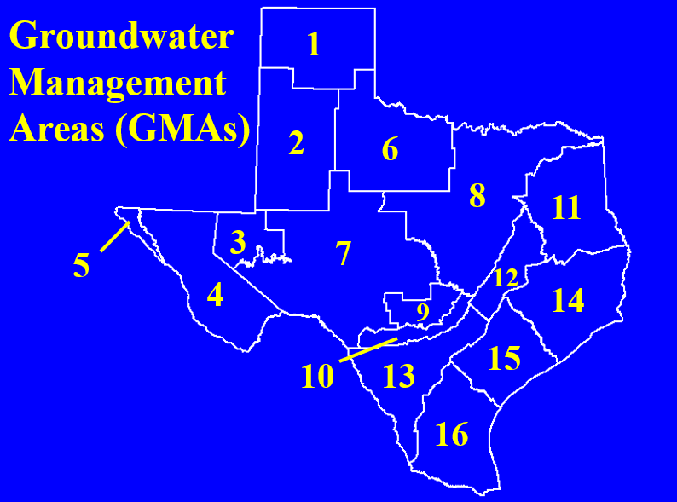
Groundwater Management Areas (GMA)
GMA 11 is one of 16 Groundwater Management Areas
  Only 15 involved in joint planning (GMA 5 has no GCDs)
Each Groundwater Conservation District (GCD) is in at least one GMA
GCDs in GMAs conduct Joint Groundwater Planning every five years
  Desired Future Conditions (DFC)
  Modeled Available Groundwater (MAG)

Slide 9
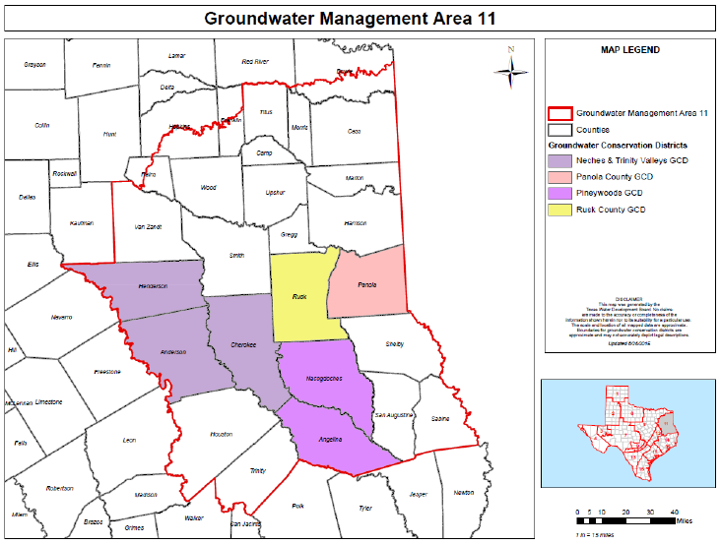

Slide 10
Geologic Formations in GMA 11 (Youngest to Oldest)
Alluvium
Jackson
Yegua
Sparta
Weches
Queen City
Reklaw
Carrizo
Wilcox

Slide 11
Geologic Formations in GMA 11 (Youngest to Oldest)
GMA 11 Aquifers
Alluvium
Jackson
Yegua
Sparta
Weches
Queen City
Reklaw
Carrizo
Wilcox
Yegua-Jackson
Sparta
Queen City
Carrizo-Wilcox

Slide 12
Geologic Formations in GMA 11 (Youngest to Oldest)
GMA 11 Aquifers
Alluvium
Jackson
Yegua
Sparta
Weches
Queen City
Reklaw
Carrizo
Wilcox
Yegua-Jackson
Sparta
“Minor” Aquifers
Queen City
Carrizo-Wilcox
“Major” Aquifer

Slide 13
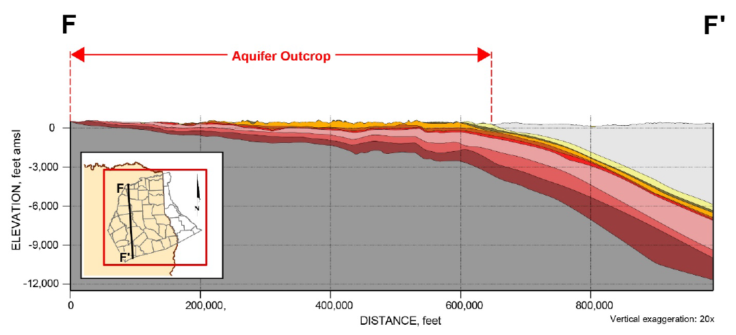

Slide 14
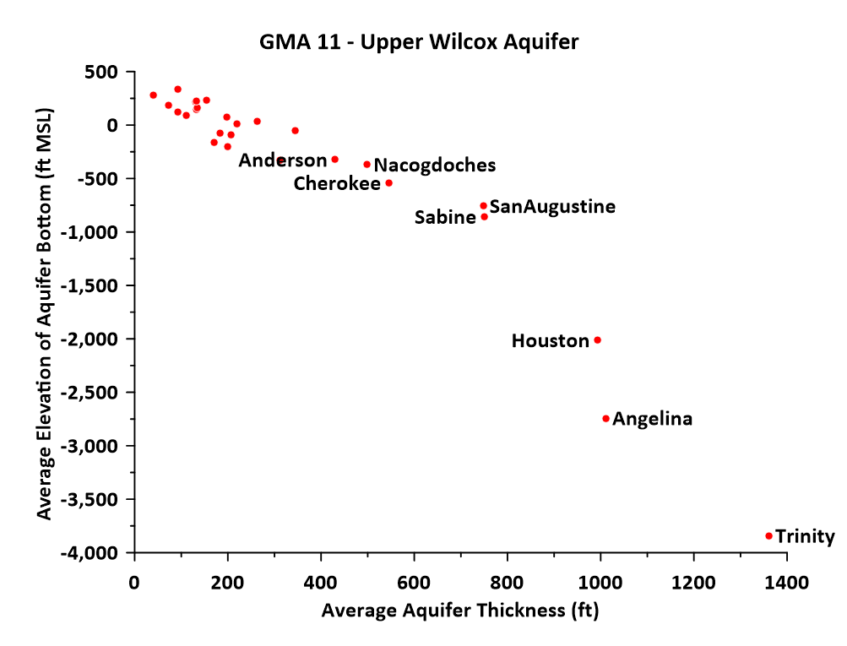

Slide 15
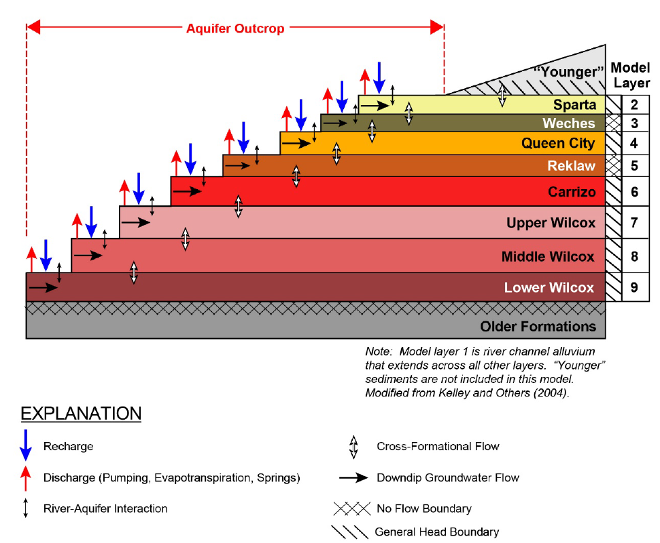

Slide 16
Groundwater Availability Models (GAMs)
In GMA 11, GAMs are used by TWDB to calculate Modeled Available Groundwater (MAG)
Models are a simplification of a groundwater system
  Groundwater occurrence and movement in aquifers
  Simulates horizontal and vertical movement of groundwater (aquifers are connected)
  Simulates surface water/groundwater interactions
GAMs are not like weather forecasting models
GAMs are analytical tools
  Best use: compare “impacts” of alternative scenarios for decision making (e.g. DFCs)

Slide 17
GAM History in GMA 11 (1)
First GAM of area: Fryar and others (2003)
  Carrizo-Wilcox Aquifer only
  Model grid size = 640 acres
  Calibration period ended in 1999
Updated by Kelley and others (2004)
  Added Sparta and Queen City Aquifers
  Model grid size = 640 acres
  Calibration period ended in 1999
GMA 11 attempted to update calibration period in 2015 and 2016
  Highlighted limitations of 2004 GAM
  Recommended that an updated model be completed in 2016 explanatory report

Slide 18
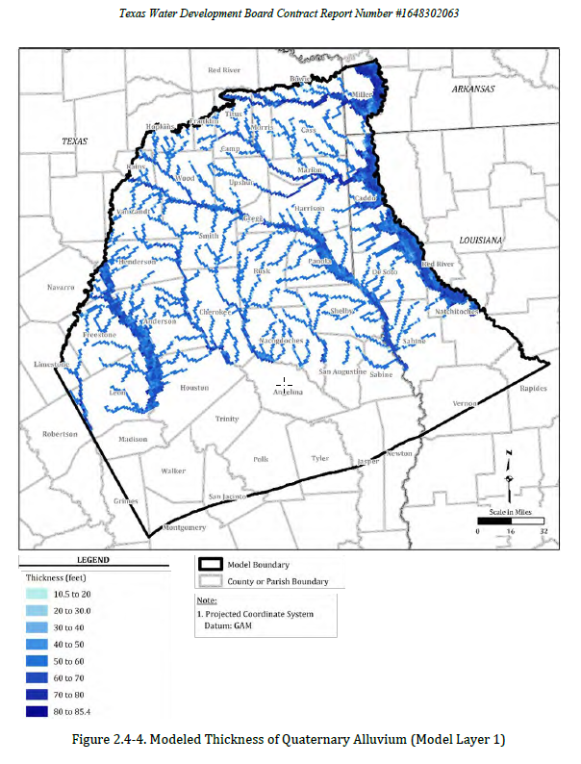
GAM History in GMA 11 (2)
TWDB contracted with GSI Environmental to update the model in 2017
Work completed in 2020 (Panday and others, 2020)
  Officially released by TWDB in April 2021
Model grid size: 10 acres to 640 acres
Added alluvial layer for improved surface water-groundwater interaction simulation
Calibration period ended in 2013

Slide 19
Joint Planning and Groundwater Availability
Before 2005
  Regional Planning Groups set “Groundwater Availability”
  No standard approach
  Numerous examples where groundwater availability was not consistent with stated goals of regional plan
  No formal mechanism where neighboring GCDs were informed of inter-district impacts of planning goals
After 2005
  Mandatory joint planning among GCDs
  Consistent approach in neighboring GCDs
  Formal process to incorporate data and models into planning decisions and the establishment of “available groundwater”

Slide 20
Desired Future Condition (DFC)
Quantified conditions of groundwater
  Specified time or times in the future
Broad Policy Goal
GMA 11 has used drawdown as the DFC metric
Updated every five years

Slide 21
Modeled Available Groundwater (MAG)
The amount of pumping necessary to achieve the desired future condition
TWDB calculation
  In GMA 11: Model simulations
Statute defines two uses for MAGs:
  “Groundwater Availability” in Regional Water Plans
  One factor in GCD permitting decisions
GCDs are required to manage to the DFC (not the MAG)

Slide 22
Groundwater Availability
=
DFC + MAG

Slide 23
Groundwater Availability
=
Policy + Science
Groundwater Availability
=
DFC + MAG

Slide 24
DFC Process Since 2011
Consider 9 specific factors
“Proposed” DFC
Public comments and public hearings
District summary reports
“Final” DFC
“Explanatory Report”

Slide 25
Nine Factors
Aquifer uses or conditions
State water plan needs and water management strategies
Hydrological conditions
  Recoverable storage (from TWDB)
  Groundwater budget
Other environmental impacts
Subsidence
Socioeconomic impacts
The impact on the interests and rights in private property
The feasibility of achieving the desired future condition
Any other relevant information

Slide 26
Nine Factors
Aquifer uses or conditions
State water plan needs and water management strategies
Hydrological conditions
  Recoverable storage (from TWDB)
  Groundwater budget
Other environmental impacts
Subsidence
Socioeconomic impacts
The impact on the interests and rights in private property
The feasibility of achieving the desired future condition
Any other relevant information

Slide 27
Nine Factors
Aquifer uses or conditions
State water plan needs and water management strategies
Hydrological conditions
  Recoverable storage (from TWDB)
  Groundwater budget
Other environmental impacts
Subsidence
Socioeconomic impacts
The impact on the interests and rights in private property
The feasibility of achieving the desired future condition
Any other relevant information

Slide 28
In Addition….
The desired future conditions proposed must provide a balance between the highest practicable level of groundwater production and the conservation, preservation, protection, recharging, and prevention of waste of groundwater and control of subsidence in the management area.

Slide 29
In Addition….
The desired future conditions proposed must provide a balance between the highest practicable level of groundwater production and the conservation, preservation, protection, recharging, and prevention of waste of groundwater and control of subsidence in the management area.

Slide 30
In Addition….
The desired future conditions proposed must provide a balance between the highest practicable level of groundwater production and the conservation, preservation, protection, recharging, and prevention of waste of groundwater and control of subsidence in the management area.

Slide 31
In Addition….
The desired future conditions proposed must provide a balance between the highest practicable level of groundwater production and the conservation, preservation, protection, recharging, and prevention of waste of groundwater and control of subsidence in the management area.

Slide 32
Joint Planning Process Tasks and Timing
Consider 9 specific factors
“Proposed” DFC and Draft Explanatory Report
Public comments and public hearings
District summary reports
“Final” DFC
Final Explanatory Report
Submit to TWDB for Review of Administrative Completeness

Slide 33
Joint Planning Process Tasks and Timing
Consider 9 specific factors
“Proposed” DFC and Draft Explanatory Report
Public comments and public hearings
District summary reports
“Final” DFC
Final Explanatory Report
Submit to TWDB for Review of Administrative Completeness
Before 5/1/2026

Slide 34
Joint Planning Process Tasks and Timing
Consider 9 specific factors
“Proposed” DFC and Draft Explanatory Report
Public comments and public hearings
District summary reports
“Final” DFC
Final Explanatory Report
Submit to TWDB for Review of Administrative Completeness
Before 5/1/2026
After Vote on “Proposed” DFC

Slide 35
Joint Planning Process Tasks and Timing
Consider 9 specific factors
“Proposed” DFC and Draft Explanatory Report
Public comments and public hearings
District summary reports
“Final” DFC
Final Explanatory Report
Submit to TWDB for Review of Administrative Completeness
Before 5/1/2026
After Vote on “Proposed” DFC
Deadline to Approve DFC = 1/5/2027

Slide 36
Review Past and Current DFCs and MAGs
Concepts behind DFCs
  Insight into “balancing” requirement
Comparison of MAGs by aquifer in first three rounds of joint planning

Slide 37
Past and Current DFCs (All Expressed as Average Drawdowns)
2010
  Focus was on increasing “availability” in Queen City Aquifer
2016
  Focus was on meeting State Water Plan needs
  Limitations with the 2004 GAM were documented
2021
  New GAM demonstrated that 2016 MAGs were not possible (aquifer limits)
  Reduced 2016 MAGs to achieve “maximum sustainable pumping”
    Using current distribution of wells, pumping is the same in each county-aquifer-river basin unit from 2014 to 2080

Slide 38
Past Balancing Efforts
In 2010, no statutory requirement for balancing
In 2016, 875 letters seeking participation were sent by GMA 11 (no response)
  One public comment (expressed support from Region D since MAGs were adequate to meet groundwater management strategies)
In 2021, no input and no public comments
  Developed “maximum sustainable pumping” in response to signals from legislature and capabilities of updated GAM

Slide 39
Maximum Sustainable Pumping
Carlos Rubenstein and Vanessa Puig-Williams were preparing a report in late 2022 and sought my input
I spoke with them on a zoom call on December 8, 2022
  Highlighted the maximum sustainable pumping approach taken in GMA 11
Report was released in January 2023
  No mention of GMA 11
  Page 21 and 22 of the report claims that there has been no sustainable yield analysis in Texas
  Much of the discussion is a critique of Total Estimated Recoverable Storage (TERS), as a joint planning factor
  Included a poorly posed question: “How much groundwater can be pumped from an aquifer without causing groundwater declines?”
    Simple answer: Zero; any pumping will cause groundwater level decline

Slide 40
Sustainable Yield
Definition: the amount of water that can be pumped from an aquifer over a specified period without causing negative or undesirable effects
  Undesirable effects can be hydrogeologic, environmental, or economic
Because of the vague definition of “undesirable effects” this sustainable yield can be twisted to mean almost anything
  Most recent literature cautions against thinking that a single number can define “sustainable yield”
From a joint planning perspective, task is to quantify, analyze, and balance “predicted” decline with other alternative scenarios (what is an “acceptable” decline?)

Slide 41
GMA 11 Considerations
Maximum sustainable pumping and sustainable yield are different
GMA 11 has adopted a DFC that recognizes aquifer limits
  As other factors are raised (via public participation), the maximum sustainable pumping provides a foundation to refine simulations to address issues of “sustainability”
Two specific metrics to evaluate “sustainability” or “sustainable yield” (discussed later in presentation):
  Impacts to streamflow
  Quantifying number of “dry wells”

Slide 42
Past and Current MAGs
Modeled Available Groundwater is the pumping that will achieve the Desired Future Condition
Calculated with GAM by TWDB

Slide 43
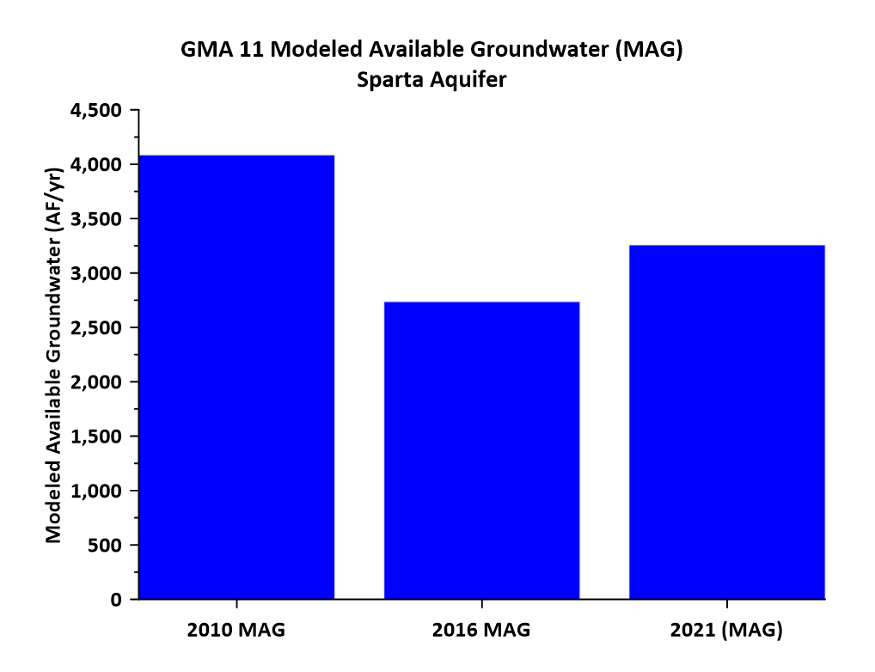

Slide 44
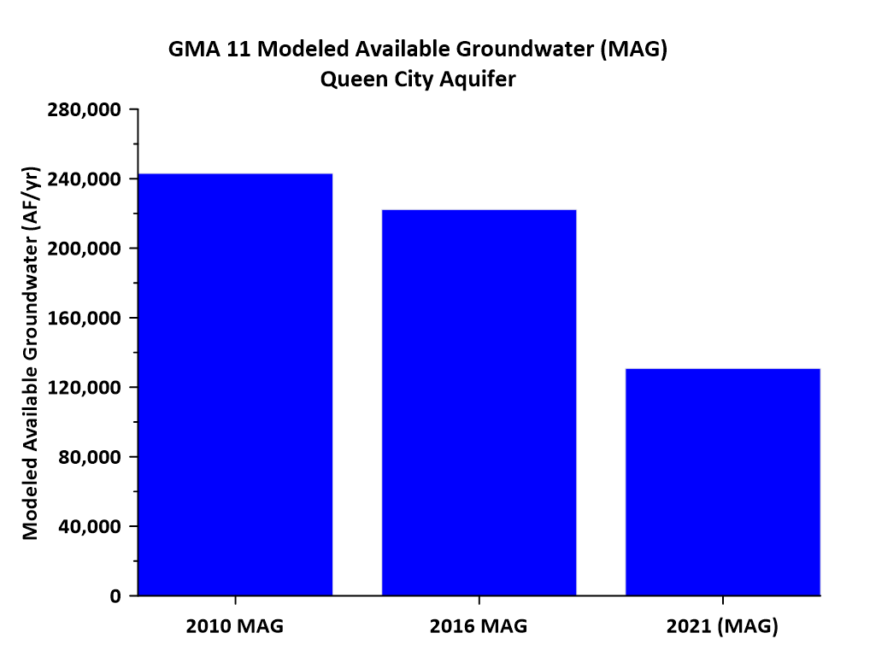

Slide 45
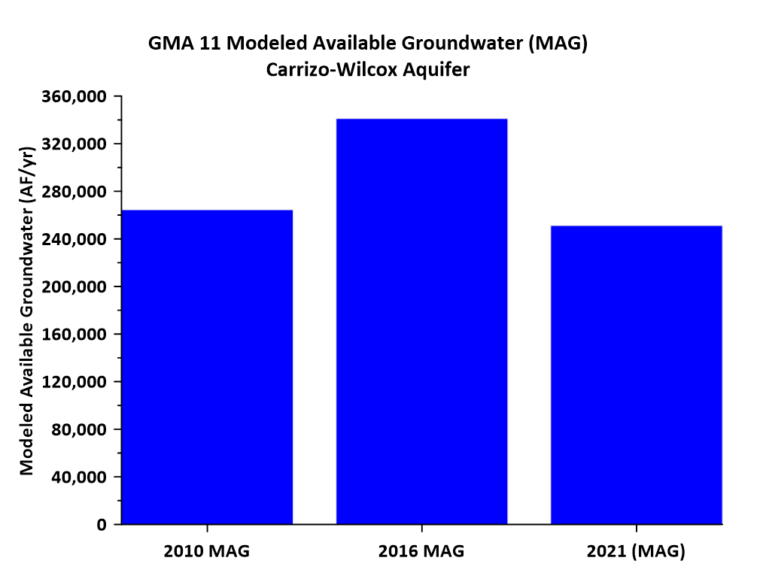

Slide 46
Reduction in MAG (2021 vs. 2016)
2016 MAGs met all State Water Plan needs
2021 MAGs represented a reduction due to aquifer limitations
  Fully documented in 2021 GMA 11 Explanatory Report and associated Technical Memoranda
Region I consultants misrepresented 2021 DFC and MAG (January 2024 meeting)
  Raised concern that groundwater availability declined
  Region I will have to “allocate the decreases in water supply”

Slide 47
From Page 3 of Region I – East Texas Regional Water Planning Group Minutes (1/10/2024 meeting)
“Andy (Donnelly) reported that some of the GMAs received an updated groundwater availability model in the middle of their planning cycle, and the groups did not have time to make the adjustments needed”
“John McFarland (Pineywoods GCD) pointed out that GMA 11 used the updated model and pumping estimates from the State, but time was not an issue in calculating water availability”
“James Beach explained some of the possible problems with the model updates and that the data may need to be adjusted in future planning cycles”

Slide 48
Is the GAM Accurate?
Groundwater models are developed with an objective
The update to the GAM for GMA 11 was focused on developing a tool for use in joint planning
  Not the same as a local scale model to assess local scale issues (e.g. permit application review)
TWDB has published standards to assess model calibration
  Updated GAM (2021) meets those standards

Slide 49
TWDB Standard for Assessing Calibration
Overall Model Results
Scaled absolute residual mean < 0.10
Overall Model
  All targets = 0.046 (18,421 data points)
  Downdip targets = 0.050 (12,395 data points)
  Outcrop targets = 0.061 ( 6,026 data points)

Slide 50
TWDB Standard for Assessing Calibration
Layer Results
Scaled absolute residual mean < 0.10
Layer-specific
  Alluvium = 0.074 ( 707 data points)
  Sparta = 0.070 ( 681 data points)
  Queen City = 0.086 (1,629 data points)
  Carrizo = 0.065 (4,969 data points)
  Upper Wilcox = 0.065 (3,458 data points)
  Middle Wilcox = 0.043 (4,147 data points)
  Lower Wilcox = 0.040 (2,830 data points)

Slide 51
Independent Check on Model Calibration as Tool for Joint Planning
TWDB database of measured groundwater elevations (1980 to 2013)
  Sparta Aquifer: 27 wells ( 435 data points)
  Queen City Aquifer: 125 wells (1,797 data points)
  Carrizo-Wilcox Aquifer: 969 wells (7,920 data points)

Slide 52
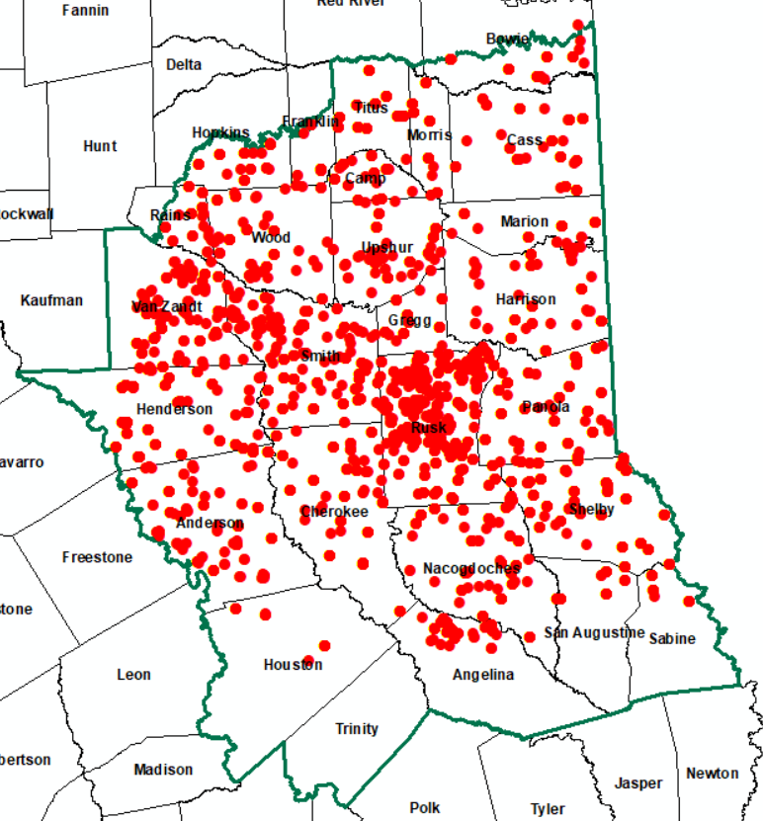
Carrizo-Wilcox Aquifer

Slide 53
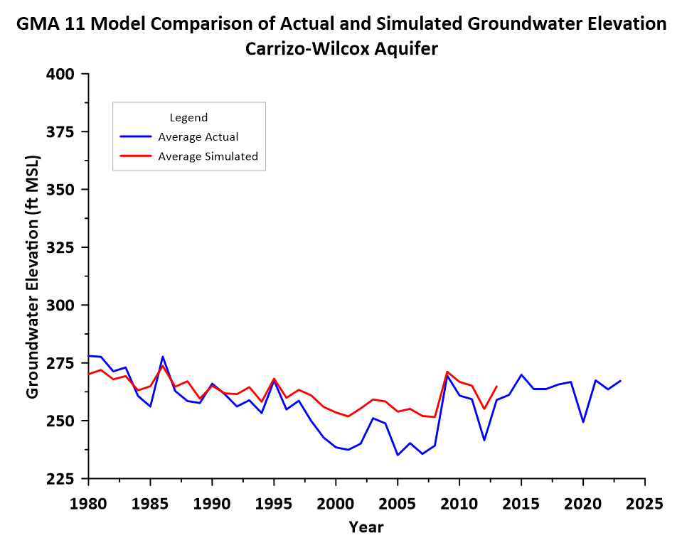

Slide 54
Assess Model Calibration
Data
After 2013

Slide 55
Nine Joint Planning Factors
Summary today
Full documentation will be included in Explanatory Report

Slide 56
Nine Factors
Aquifer uses or conditions
State water plan needs and water management strategies
Hydrological conditions
  Recoverable storage (from TWDB)
  Groundwater budget
Other environmental impacts
Subsidence
Socioeconomic impacts
The impact on the interests and rights in private property
The feasibility of achieving the desired future condition
Any other relevant information

Slide 57
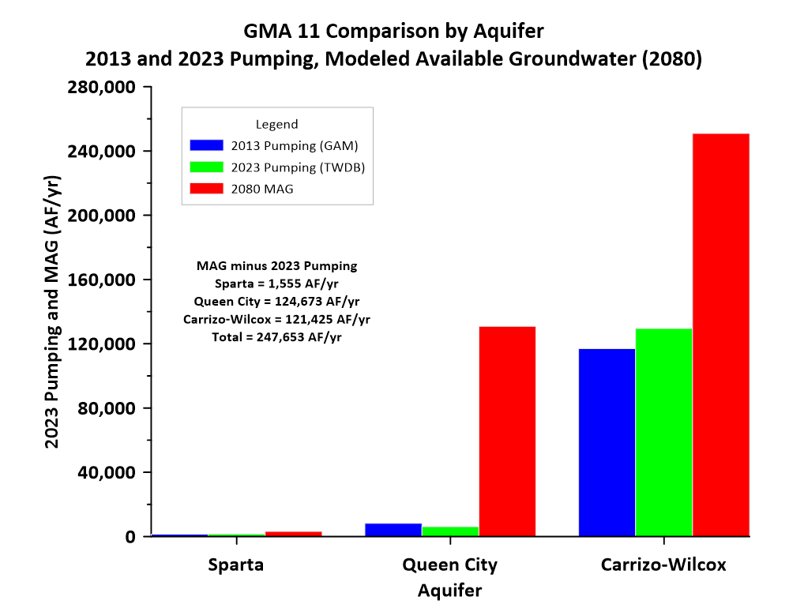
DFC Factor 1

Slide 58
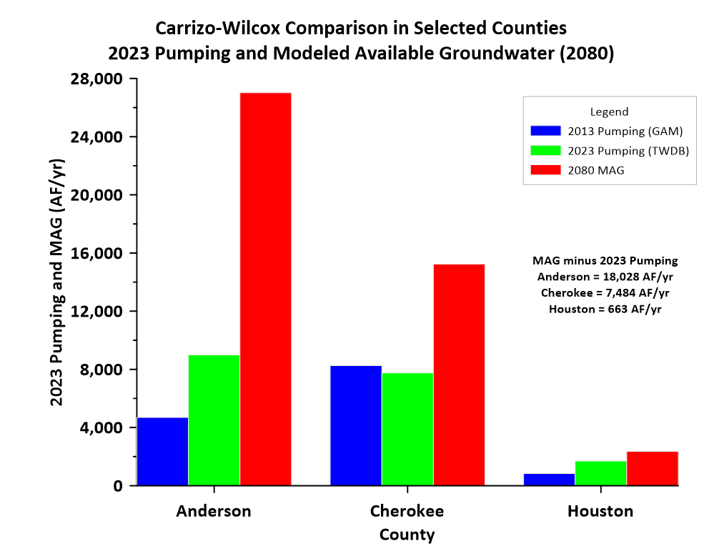
DFC Factor 1

Slide 59
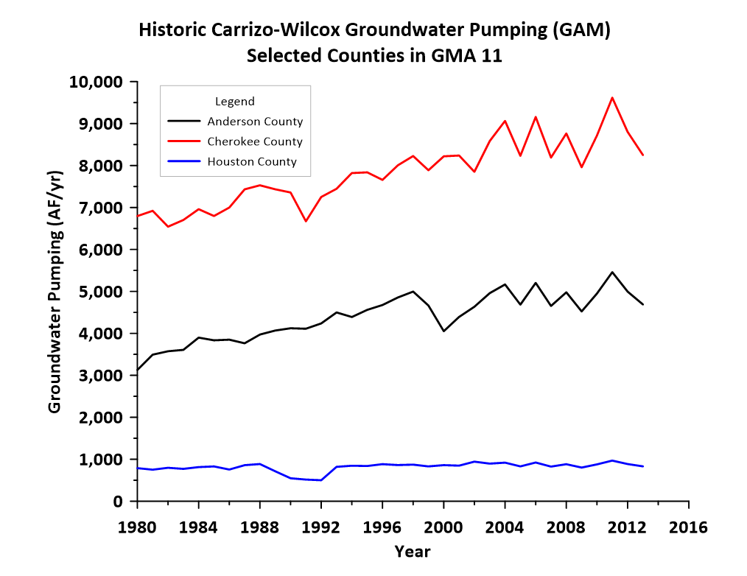
DFC Factor 1

Slide 60
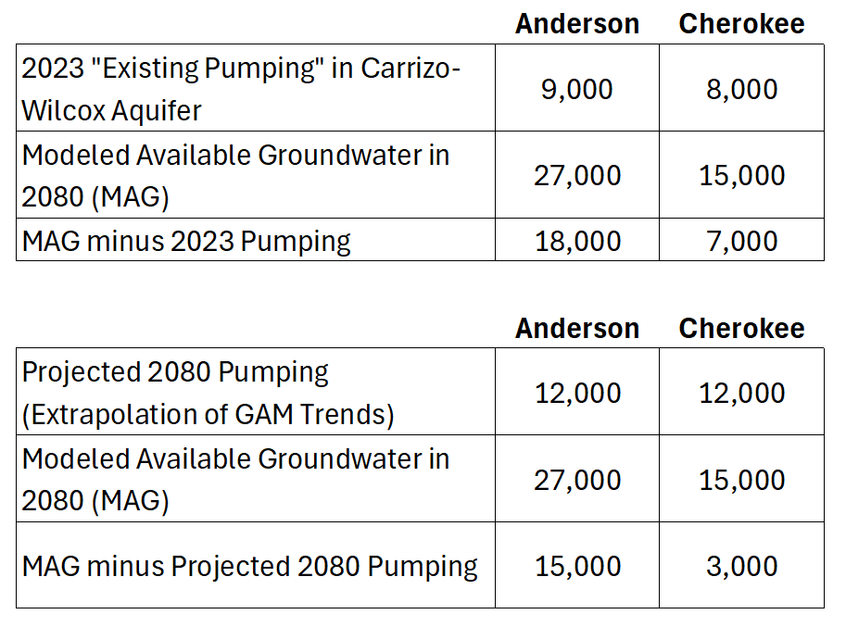
MAG Context (Examples)
DFC Factor 1

Slide 61
Regional Water Plan/State Water Plan
DFC Factor 2
Previously described Region I issues
  2021 MAG vs 2016 MAG
If GMA 11 adopts different DFCs, it is possible that MAGs may be reduced further in 2026/2027
Fundamental policy question as part of balancing:
  More weight to aquifer limits or to state water plan needs?

Slide 62
Storage (Physical Availability?)
DFC Factor 3
TWDB Storage Estimates
  Total Estimated Recoverable Storage or TERS
2021 Explanatory Report Estimates
Refined Estimates from 2021 (Unofficial)

Slide 63
Total Groundwater Storage in GMA 11
DFC Factor 3
TWDB (2014) = 2,071 million acre-feet (2 billion AF)
  Based on 2004 GAM parameters
  2021 Explanatory Report discussed that this estimate may be too high
Updated “unofficial” estimate (for this round of joint planning)
  Confined Artesian = 1.2 million AF
  Confined Saturated = 13.1 million AF
  Unconfined = 14.8 million AF
  Total = 29 million AF
    Carrizo-Wilcox Aquifer Total = 20 million AF

Slide 64
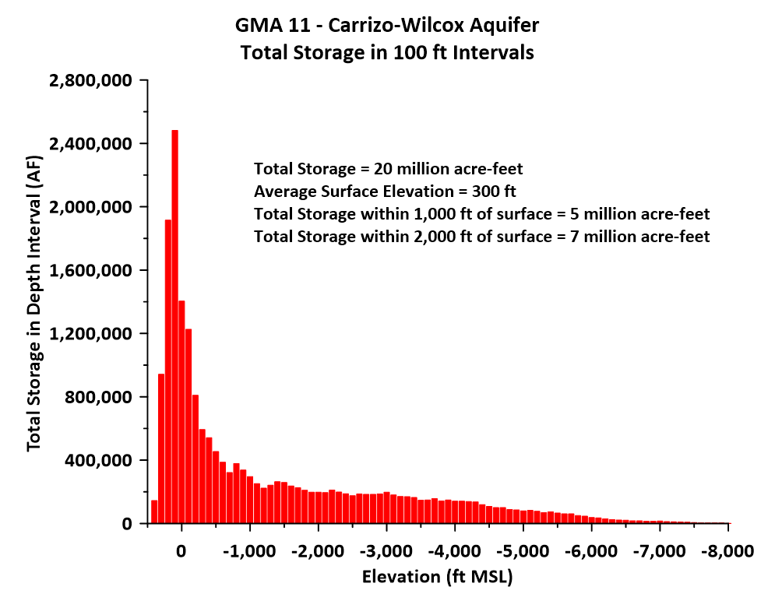
DFC Factor 3

Slide 65
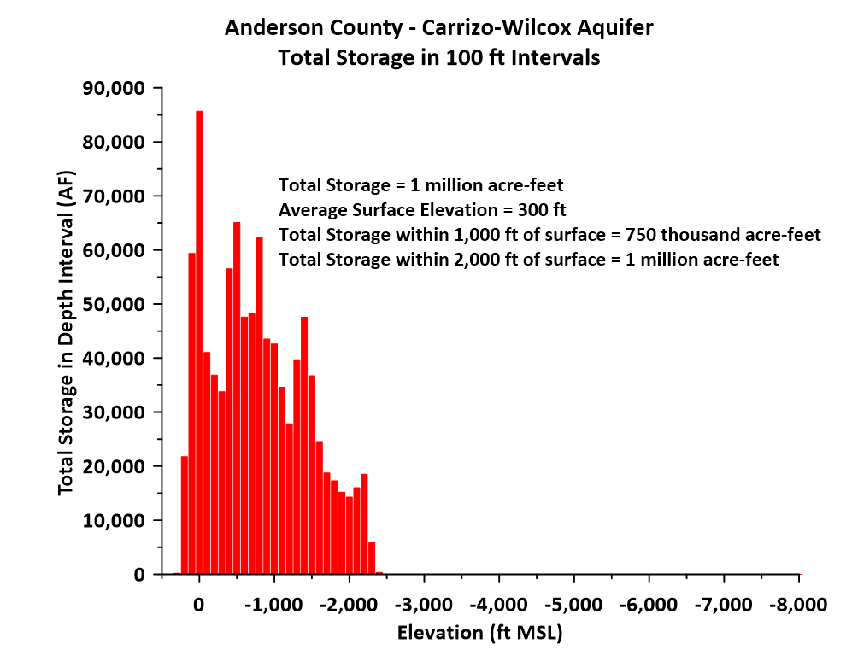
DFC Factor 3

Slide 66
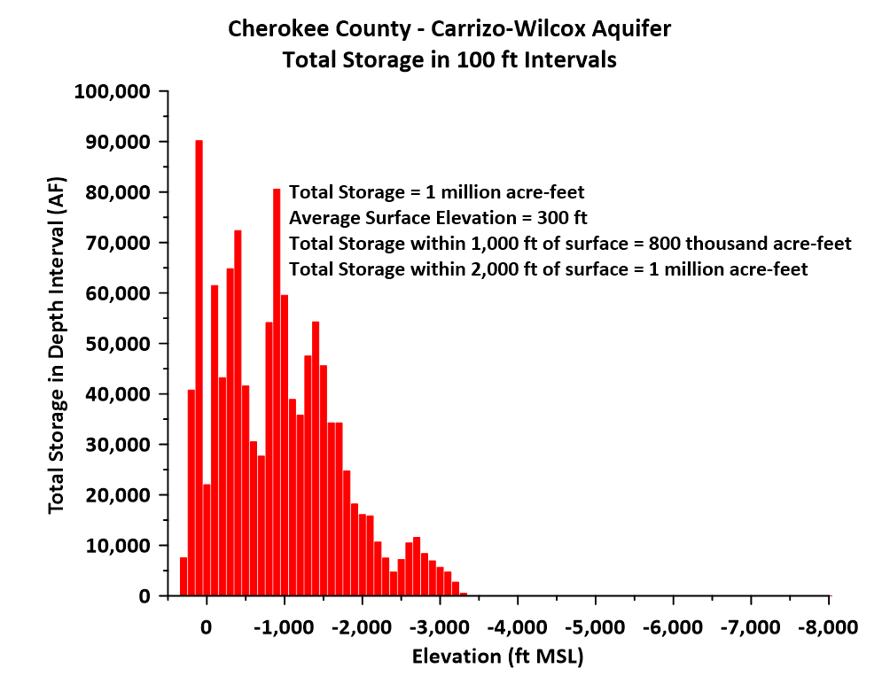
DFC Factor 3

Slide 67
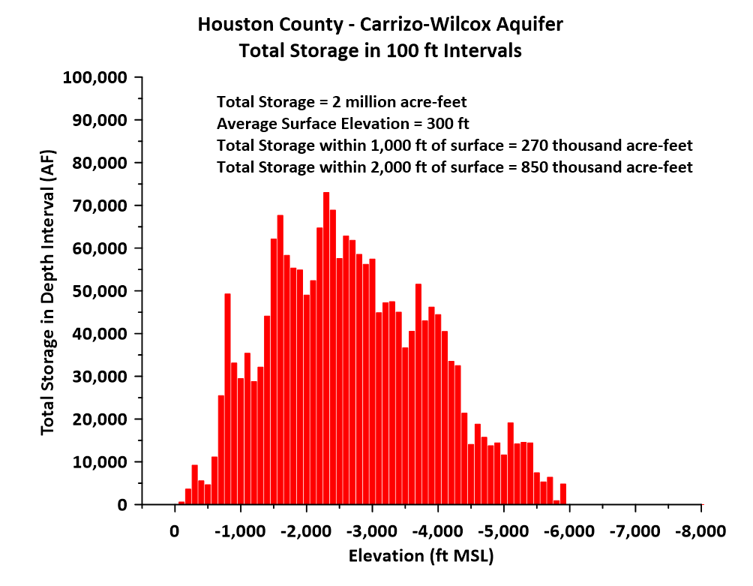
DFC Factor 3

Slide 68
Total Estimated Recoverable Storage
DFC Factor 3
Not a useful factor (should be dropped as a factor for joint planning)
Frequently misused to advance a false narrative
  “Proposed pumping is a small fraction of total storage”
Groundwater pumping is from a dynamic system
  Impacts of pumping can be analyzed with groundwater budgets

Slide 69
Groundwater Budget Analysis
DFC Factor 3
Documented in 2021 Explanatory Report
Focuses on an analysis of “capture”
Literature on “capture” dates to 1940
Increased pumping impacts:
  Reduced storage
  Induced inflow
  Captured outflow
Literature in 1982 and 2002 noted that groundwater models are ideal tools to analyze “capture”
  Also emphasized that natural rate of recharge is not relevant
Side Note: from 2009 to (at least) 2011, TWDB groundwater modeler employment interview questions included a hypothetical capture analysis

Slide 70
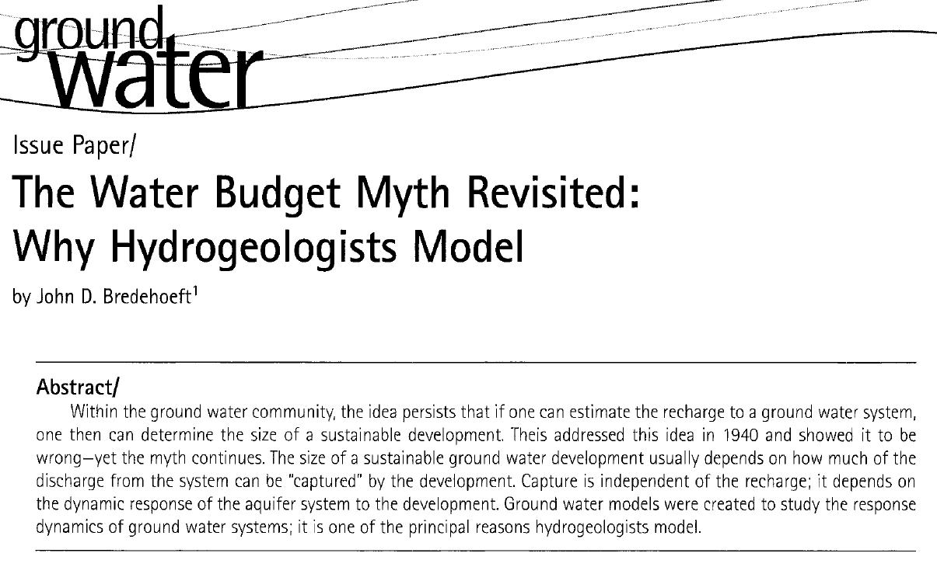
From Ground Water
Vol. 40, No. 4
July-August 2002
DFC Factor 3

Slide 71
DFC Results in a Pumping Increase Compared to Historic Pumping
DFC Factor 3
“Maximum Sustainable Pumping”
  Assumed current distribution of wells
  Pumping is “sustained” from 2014 to 2080
Average pumping:
  1981 to 2013: 129,718 AF/yr
  2014 to 2080: 385,088 AF/yr
  Increase: 255,370 AF/yr

Slide 72
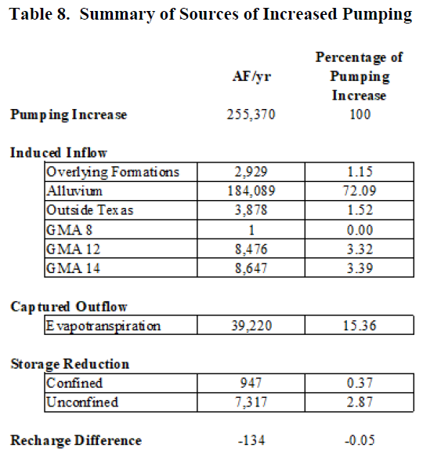
From 2021 Explanatory Report
DFC Factor 3

Slide 73
From 2021 Explanatory Report
DFC Factor 3
Pumping increase:
255,000 AF/yr

Slide 74
From 2021 Explanatory Report
DFC Factor 3
3% of pumping
increase is
from storage

Slide 75
From 2021 Explanatory Report
DFC Factor 3
72% of pumping
increase is
from induced inflow of surface water

Slide 76
From 2021 Explanatory Report
DFC Factor 3
15% of pumping
increase is
from reduced evapotranspiration

Slide 77
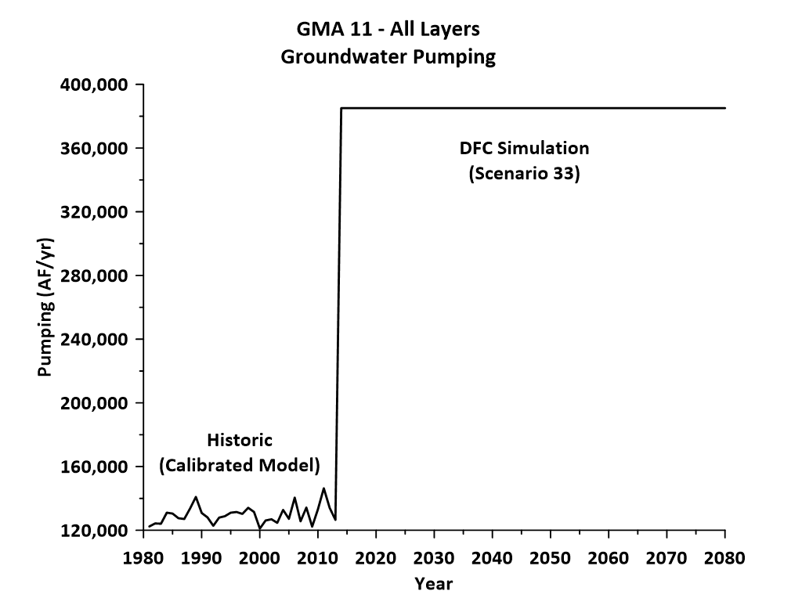
DFC Factor 3

Slide 78
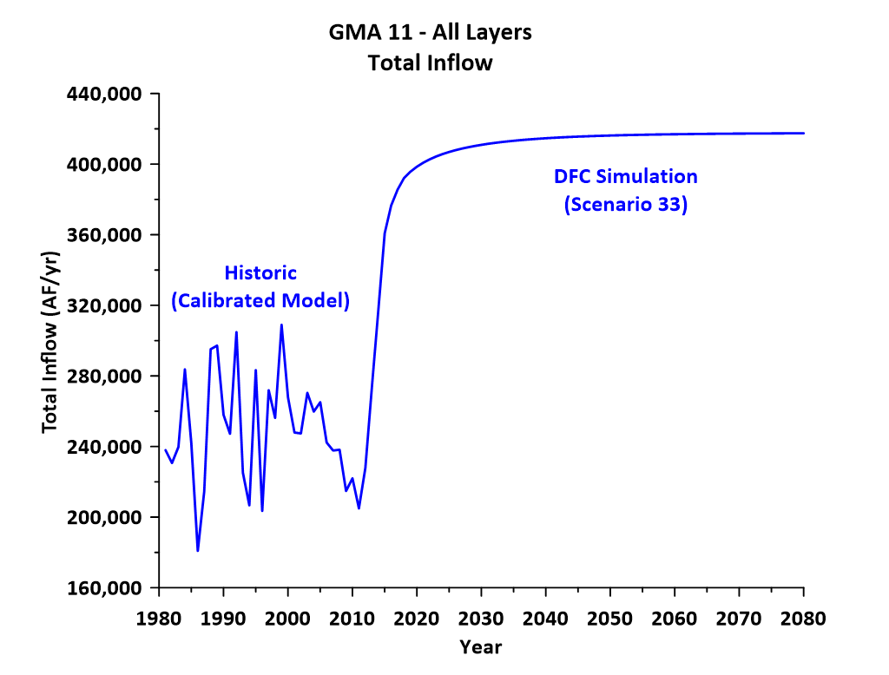
DFC Factor 3

Slide 79
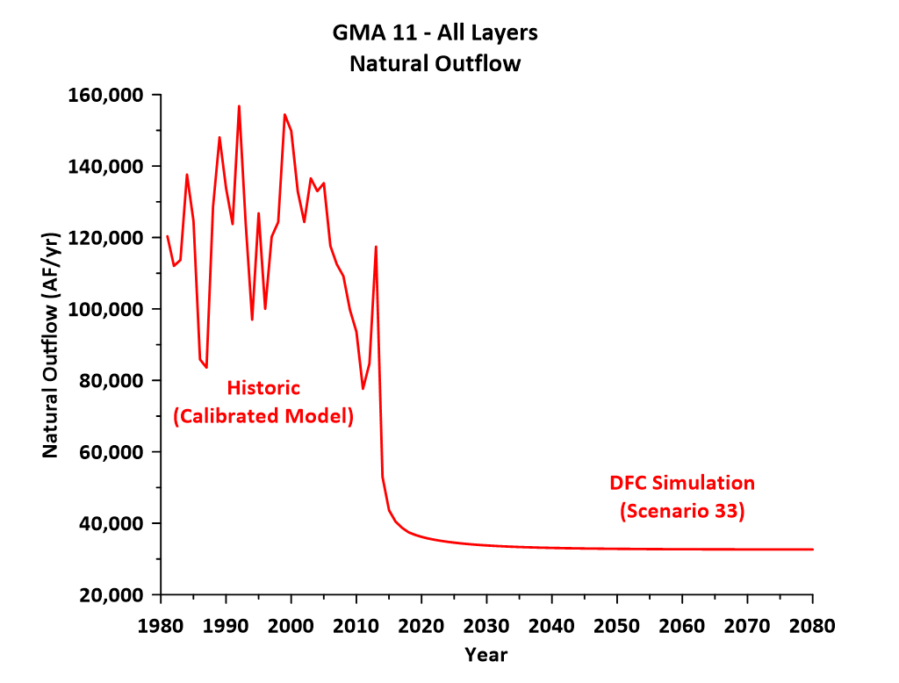
DFC Factor 3

Slide 80
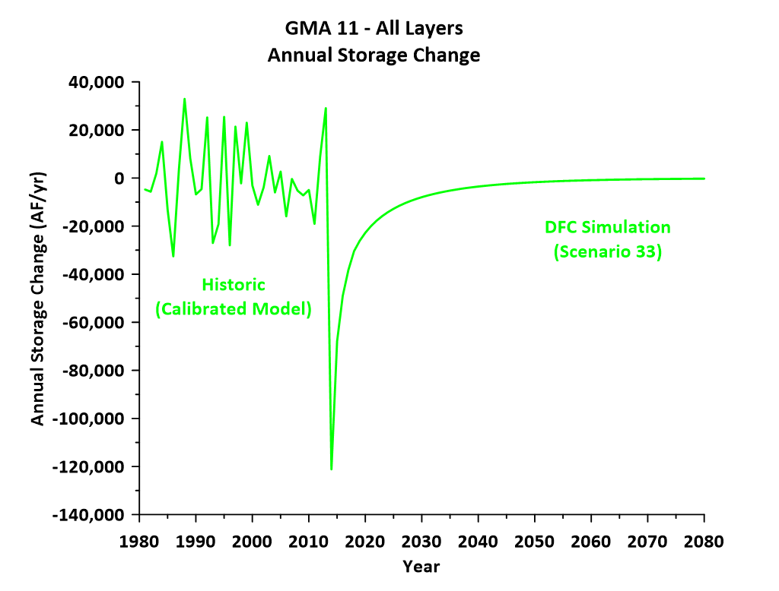
DFC Factor 3

Slide 81
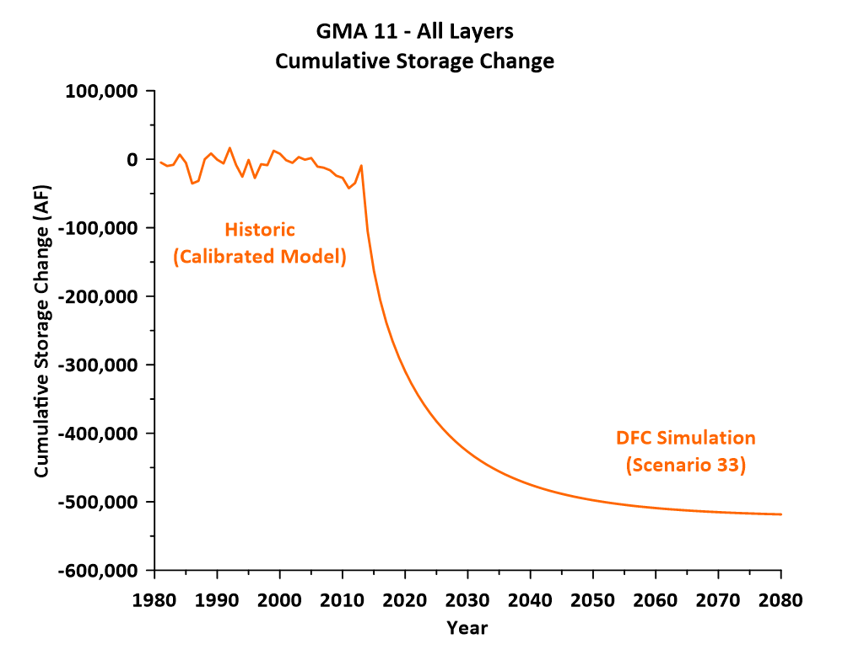
DFC Factor 3

Slide 82
Storage Analysis
DFC Factor 3
Pumping Increase = 255,000 AF/yr
  Cumulative Pumping (2014 to 2080) = 17.1 million AF
Cumulative Storage Decline = 518,000 AF
Cumulative Storage Decline is about 3 % of Cumulative Pumping
Cumulative Storage Decline is about 2 % of Initial Total Storage

Slide 83
Storage Analysis
DFC Factor 3
Pumping Increase = 255,000 AF/yr
  Cumulative Pumping (2014 to 2080) = 17.1 million AF
Cumulative Storage Decline = 518,000 AF
Cumulative Storage Decline is about 3 % of Cumulative Pumping
Cumulative Storage Decline is about 2 % of Initial Total Storage
What are the impacts of a 2 % decline in total storage?
Will be covered in discussion of Factors 6 and 7

Slide 84
Other Environmental Impacts
DFC Factor 4
Recommend that current round of joint planning focus on surface water impacts for this factor
Work is in progress to develop more detailed groundwater budgets for “induced inflow” for current round of joint planning
  Main rivers
  Tributaries
  Lakes
Will be documented in tech memo and explanatory report
Side note: reduced evapotranspiration used to be considered “conservation” of water (1950s and 1960s)
  Definition is different today

Slide 85
Subsidence
DFC Factor 5
Historically, not an issue in aquifers of GMA 11
2021 Explanatory report documented results of the TWDB Subsidence Tool (0 is low risk, 10 is high risk)
  Sparta = 3.91(subsidence of 0 feet)
  Queen City = 4.22 (subsidence of 0 feet)
  Carrizo-Wilcox = 4.53 (subsidence of 0.16 feet)

Slide 86
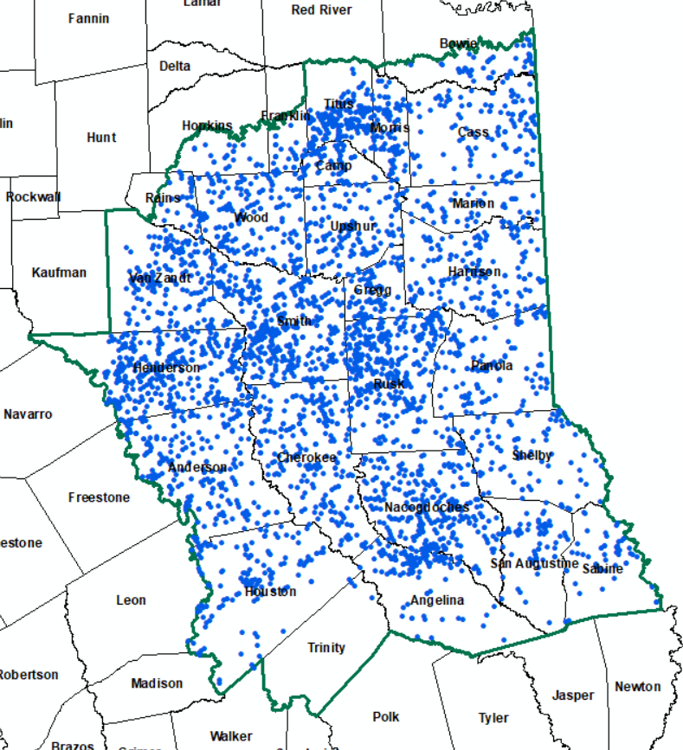
Well Locations in GMA 11
DFC Factors 6 and 7
TWDB Database (Well Locations and Depths)
5,786 wells in GMA 11
4,217 wells with good depths (depicted on map)

Slide 87
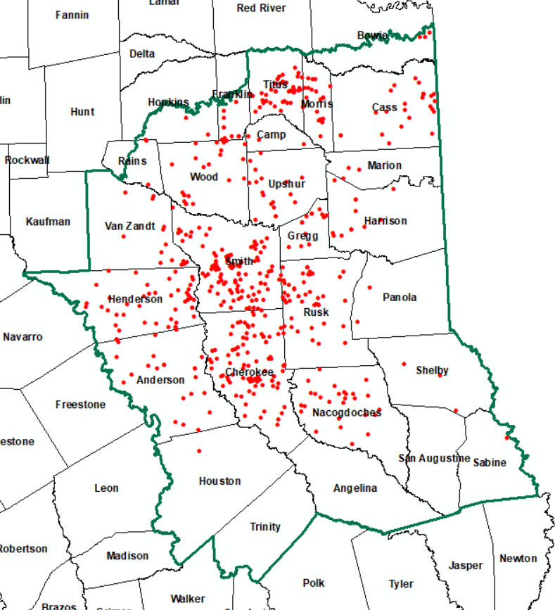
Dry Wells in 2080
DFC Factors 6 and 7
For each well in database:
  Compared simulated 2080 groundwater elevation to well bottom elevation (plus 20 feet)
  568 wells would be dry by 2080
  Categorized by county and model layer

Slide 88
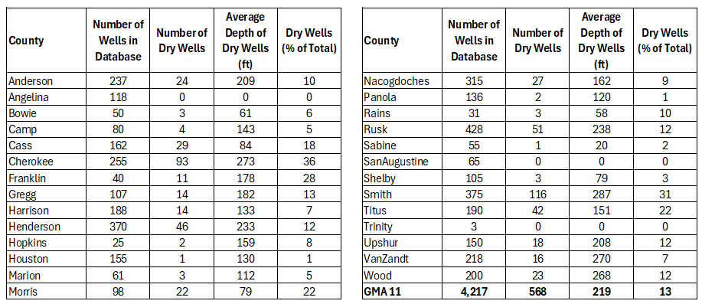
Dry Well Analysis – County Based
DFC Factors 6 and 7

Slide 89
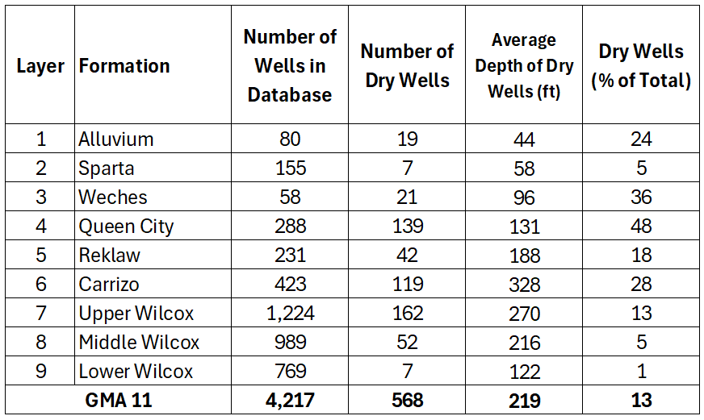
Dry Well Analysis – Model Layer Based
DFC Factors 6 and 7

Slide 90
Dry Well Analysis – Model Layer Based
DFC Factors 6 and 7

Slide 91
Additional Simulations are Recommended
DFC Factors 6 and 7
Propose scenarios with reduced Queen City and Carrizo-Wilcox pumping
  Update the dry well analysis
  Compare with current DFC/MAG pumping
  GMA 11 can balance production with conservation (maintain existing wells)
Results of additional simulations will also include evaluating and comparing impacts to surface water (discussed earlier)

Slide 92
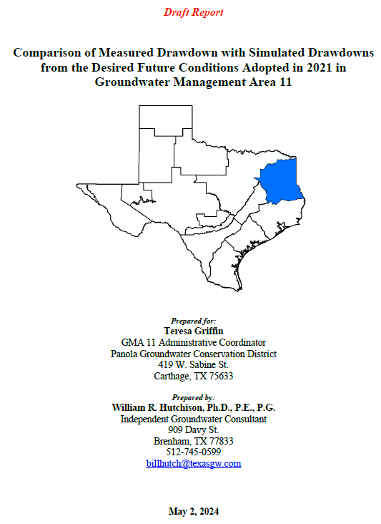
GMA 11 Meeting
May 15, 2024
DFC Factor 8
Compared measured drawdown with simulated drawdowns
Draft report and presentation at GMA 11 meeting
Conclusion:
  Actual drawdowns are less than simulated drawdowns (DFC)
  Expected conclusion given the “high” pumping associated with the MAG
This work is consistent with new requirements of HB 2078

Slide 93
Other Relevant Information
DFC Factor 9
None

Slide 94
Recommendations
Additional GAM simulations for this round of joint planning:
  Reduced Queen City pumping
  Reduced Carrizo-Wilcox pumping
Evaluate GAM output from additional simulations
  Number of dry wells
  Surface water impacts
Compare alternative scenarios with current DFC simulation
  Information for GMA 11’s balancing task
GAM Update
  Need to update and improve GAM (for next round of joint planning)
  Detailed recommendations will be developed

Slide 95
Recommend Adaptive Management and Reject Regional Correlative Rights
Current Joint Planning Process is “Adaptive Management”
  Update DFCs every five years
  Use updated data, information, models
  Explanatory report identifies issues for improvement during next cycle
  Acknowledges uncertainty and seeks to constantly improve knowledge
Regional Correlative Rights
  Can rely too heavily on storage (poor metric)
  Seeks “regulatory certainty” now when groundwater data and models are constantly improving
  Homogenizes a system with inherent variability
    Equal outcomes for groundwater at 500 ft depth and 5,000 ft depth
    Equal outcomes for areas of high transmissivity and low transmissivity
  Attempts to factor in differences ignores the fact that local data will constantly improve with new groundwater development
    Compromises the “regulatory certainty” that is sought

Slide 96
Recommended Factor Update (for consideration during legislative interim)
Past DFC Achievement
Historic and Projected Groundwater Pumping
  TWDB estimates
  GAM estimates
  RWPG estimates
Analysis of Hydrogeologic Impacts of DFC
  Storage decline
  Induced inflow
  Captured outflow
  Subsidence
Analysis of Dry Wells
Any other relevant information

Slide 97
Summary
Groundwater Availability is defined in statute
  Modeled Available Groundwater
Total storage is not relevant and is not a good factor for joint planning
  Misleading and is used to advance false narratives
  Factor should be removed from joint planning process
Heavy reliance on state water plan needs pushes GMAs to higher groundwater availabilities
  DFCs should focus on aquifer capabilities, not on meeting “inexpensive” needs
  Some other factors should be removed or modified by legislature
In 2021, GMA 11 advanced concepts related to “maximum sustainable pumping” without recognition
  This round of joint planning represents an opportunity to refine this concept to include additional elements of sustainable use

Slide 98
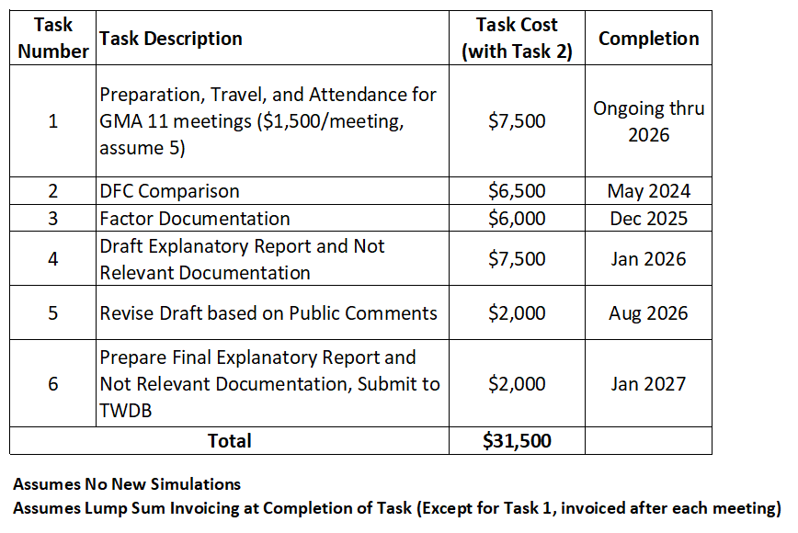
Budget Approved at Last GMA 11 Meeting (May 15, 2024)

Slide 99
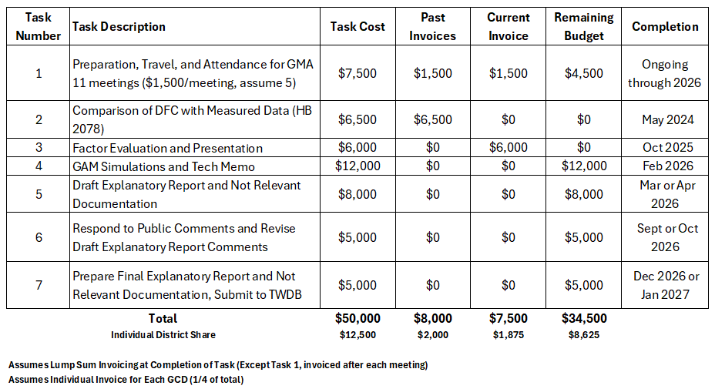
Proposed Budget Update

