Slide 1
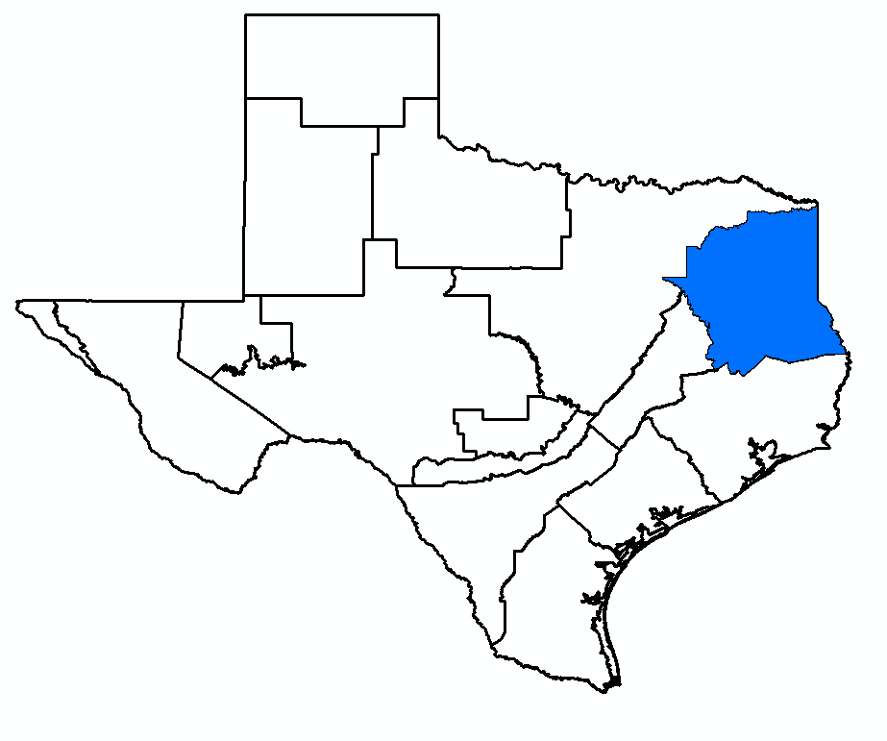
GMA 11 Meeting: Model Recalibration/Limitations (TM 16-01) Summary of Scenario 4 (TM 16-02) Storage Discussion
Bill Hutchison, Ph.D., P.E., P.G.
GMA 11 Meeting
March 22, 2016

Slide 2
Topics
Technical Memorandum 16-01 (Model Recalibration and Model Limitations)
Technical Memorandum 16-02 (Summary of Scenario 4)
Storage discussion

Slide 3
Updating Model Calibration
Attempts to update model calibration period did not yield a result that was as good or better than 1975 to 1999 calibration period
Identified limitations of the model that are useful in using Scenario 4 results (or results of any scenario) for development of DFCs
Documented in Technical Memorandum 16-01

Slide 4
Summary of Effort
9 PEST runs
Total of 7,610 model runs
2000 to 2013 Recharge and ET based on rainfall relationship
Pumping based on two approaches:
TWDB estimates for 2000 to 2013
Use 1999 pumping from model and allow PEST to adjust to improve fit

Slide 5
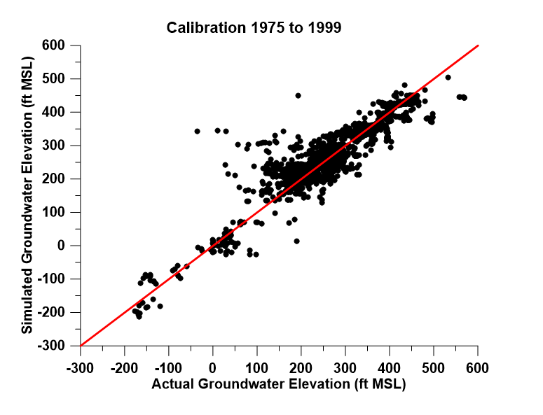

Slide 6
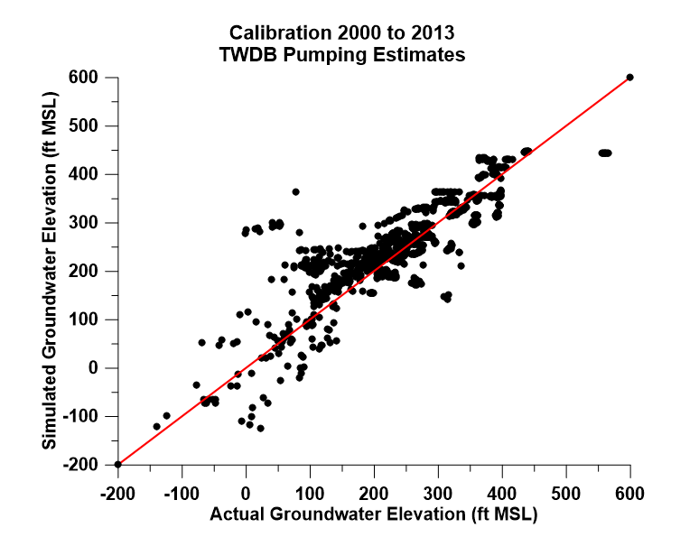

Slide 7
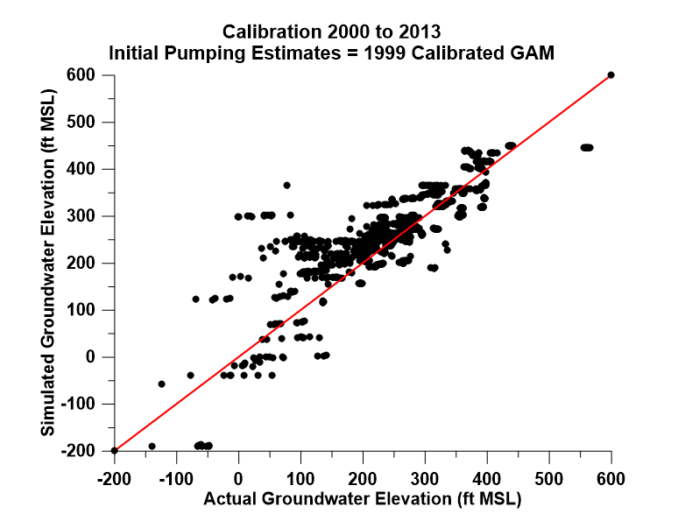

Slide 8
Limitations Identified
Problems in outcrop areas
Use Carrizo as the example
Complex relationship between recharge, ET, discharge to surface water and movement downdip
Storage in outcrop area is increasing from 1975 to 1999 in calibrated model
Changes in storage are well correlated with recharge

Slide 9
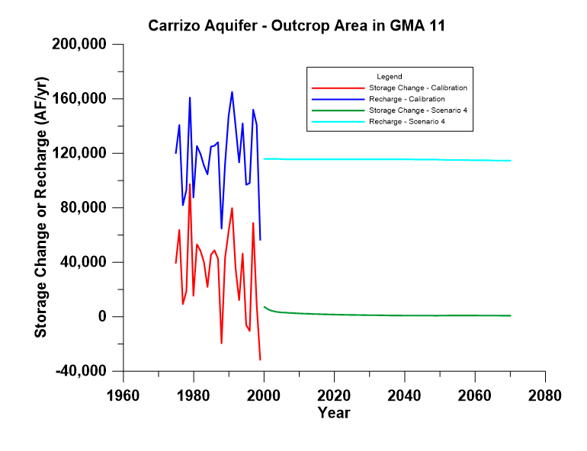

Slide 10
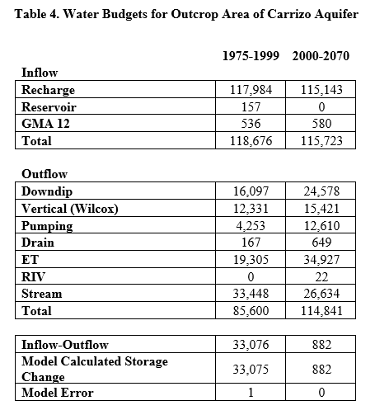

Slide 16
Discussion
Comparison of 1975-1999 and 2000-2070
Recharge is the same
Pumping increases
Expect decrease in other outflows and increased inflows
ET and Downdip movement increase (not expected)
Appears that water cannot discharge, so storage increases
ET goes up due to higher heads
May be related to high specific yield numbers and not enough downdip movement of water

Slide 17
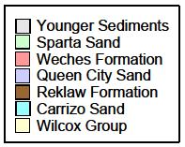
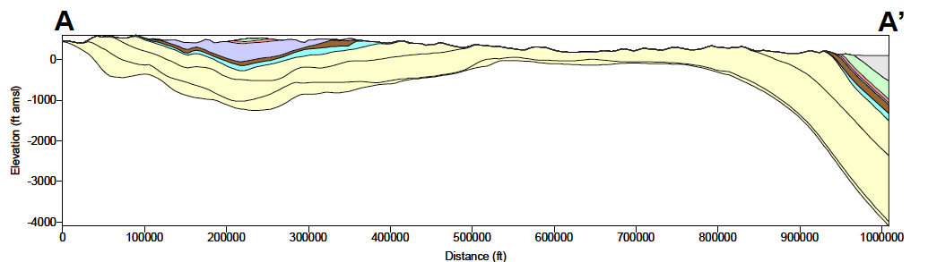
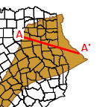
From Kelley and others (2004)

Slide 18
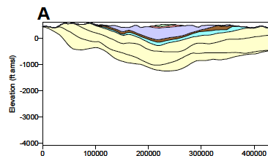
From Kelley and others (2004)

Slide 19
From Kelley and others (2004)

Slide 20
GMA 11 area
58,269 cells in downdip areas of all aquifers
4,623 cells (8 percent) in 1999 groundwater elevation below the top of the aquifer
Uses specific yield and not storativity to estimate changes in head
Model may not accurately simulate decreases in groundwater levels due to pumping due to use of higher specific yield value (rather than storativity)
Simulated gradient is flatter than reality – can’t move water from outcrop to downdip
Storage in outcrop area increases

Slide 21
Implications for DFC
Note that storage in Scenario 4 is flat (just slightly positive)
Can assume that “negative” drawdowns should be zero for DFC calculations (see TM 16-02)

Slide 22
Good News
TWDB is expected to update model of Northern Carrizo-Wilcox, Queen City and Sparta
TWDB approved advertising for RFQs for model update (March 21, 2016 TWDB meeting)
Work is expected to begin later this year
$800,000 budget
2 to 3 year completion
New model should be available for next round of joint planning (proposed DFC in spring 2021)

Slide 23
Topics
Technical Memorandum 16-01 (Model Recalibration and Model Limitations)
Technical Memorandum 16-02 (Summary of Scenario 4)
Storage discussion

Slide 24
Summary of TM 16-02
Scenario 4 chosen since it met the objectives of GMA 11
Included previous MAG concepts (i.e. Queen City)
Included RWP strategies (recommended and alternative)
Included Forestar project
TM can be viewed as a template
Tables for a different scenario could be substituted
Objective was to provide a summary suitable for presentation to GCD Boards

Slide 25
Overview
Table 1 – pumping from Scenario 4
Table 2 – drawdown from Scenario 4 (raw)

Slide 26
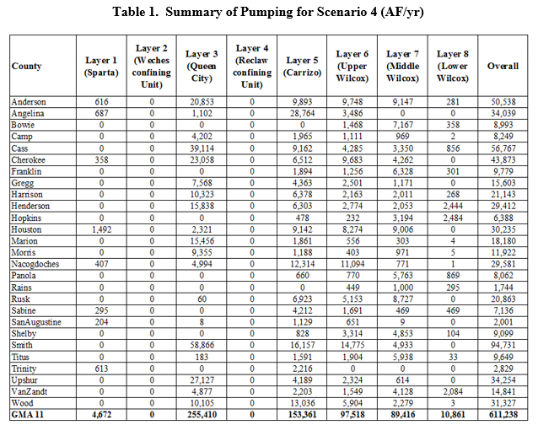

Slide 27
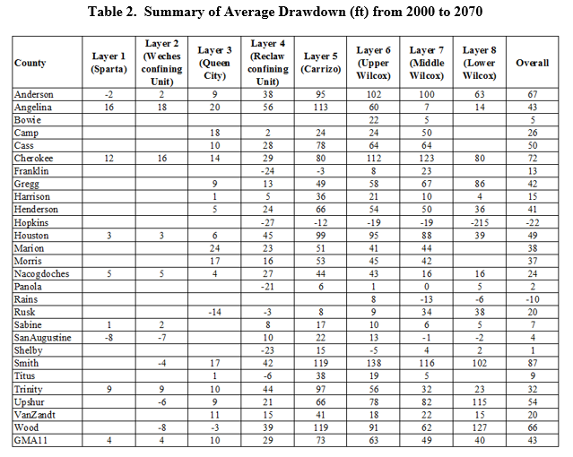

Slide 28
Average Drawdown
Not equal drawdown throughout county
Model cells are 1 square mile
Drawdowns in each cell in a specific county and model layer is summed and then divided by the number of active cells in that county in the model layer
Number of active cells is adjusted to account for dry cells (removed from calculation)
Table 3 has active cells in 2070

Slide 29
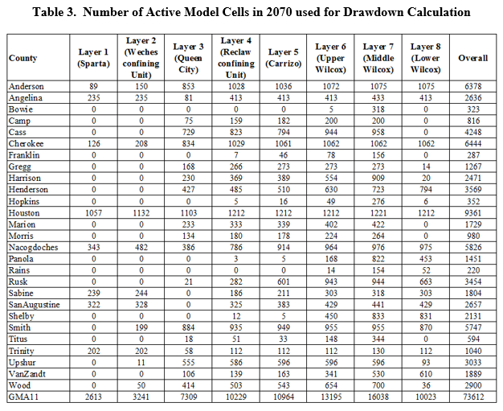

Slide 30
27 Instances of Negative Drawdown in 2070 in Scenario 4
Table 4 summarizes these occurrences
County
Layer
Drawdown
Number of Active Cells
Number of Dry Cells
Pumping
Percent of Active Area to Total Area of County in GMA 11

Slide 31
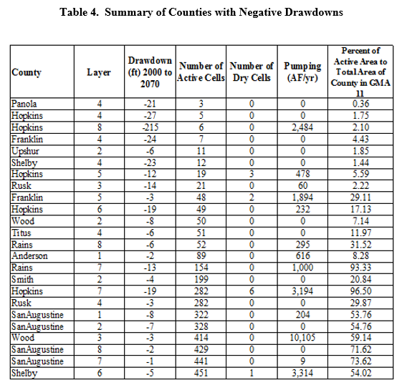

Slide 32
Observations
16 of the 27 are in areas less than 200 square miles
8 of the 27 are in areas greater than 200 square miles
One in layer 2 and one in layer 4 (confining units)
Recommend that DFCs are defined in aquifer units only
Of the six remaining, recommend setting negative drawdowns to zero and recalculating average drawdown
Model limitation discussed earlier
San Augustine County – Layer 8 as example

Slide 33
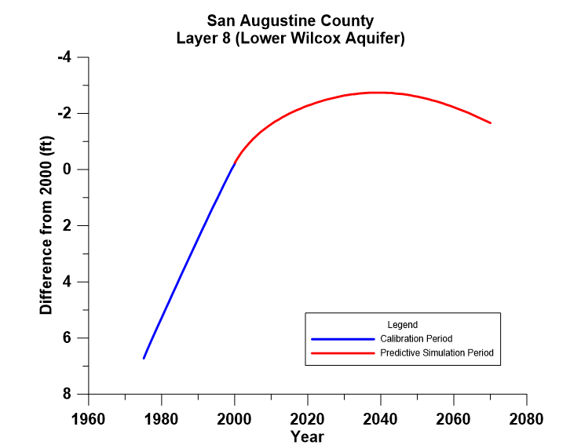

Slide 34
Summary of Recommendations
Remove layers 2 and 4 (confining units) from DFC consideration
Remove all areas less than 200 square miles (potential monitoring difficulties)
Substitute six instances of negative average drawdown with recalculated average drawdown as described
Panola County GCD will provide their values based on Wade’s work

Slide 35
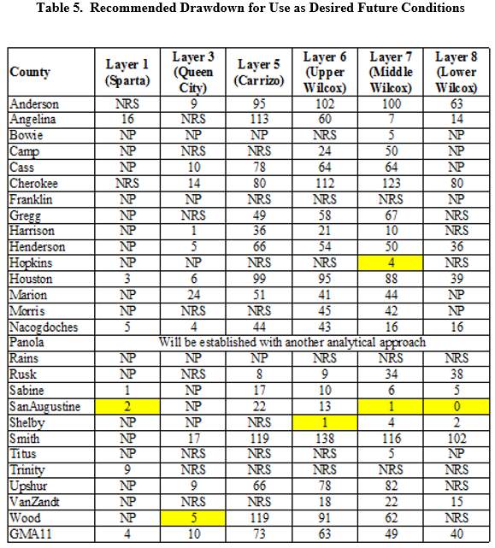


Slide 36
Topics
Technical Memorandum 16-01 (Model Recalibration and Model Limitations)
Technical Memorandum 16-02 (Summary of Scenario 4)
Storage discussion

Slide 37
Storage Discussion
Part of DFC Factor 3
TWDB Report (GAM Task 13-034)
Aquifer | Total Storage (million acre-feet) | Estimated Range of Recoverable Storage (million acre-feet)
Sparta | 55.3 | 13.8 to 41.5
Queen City | 142.0 | 35.5 to 106.5
Carrizo-Wilcox | 2,070.6 | 517.7 to 1,553.0

Slide 38
Model Limitations and Storage
Issues identified and discussed today suggest that some model parameters used in storage calculations may need updating
How those parameters affect storage calculations already completed by TWDB

Slide 39
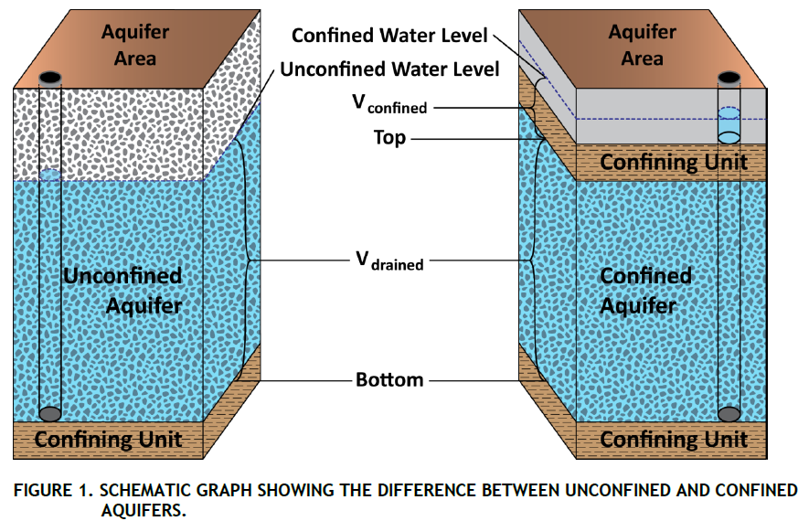
Storage Calculations by TWDB
Three components
Outcrop area
Artesian portion of downdip area
Saturated portion of downdip area

Slide 40
Outcrop Area
Saturated thickness: 1999 groundwater elevation minus aquifer bottom elevation
Storage = Saturated thickness * Area * Specific Yield
Area = 640 acres per cell
Specific yield = 0.1 or 0.15 depending on layer
Carrizo-Wilcox Aquifer Outcrop = 114 million AF

Slide 41
Artesian Portion of Downdip
Artesian zone thickness: 1999 groundwater elevation minus elevation of top of aquifer
Storage = Artesian zone thickness * Area * Storativity
Area = 640 acres per cell
Storativity ranges from 7.3E-05 to 9.93E-03
Carrizo-Wilcox Aquifer Artesian Storage = 65 million AF

Slide 42
Saturated Portion of Downdip Area
Saturated zone thickness:
If head below top of aquifer, 1999 groundwater elevation minus elevation of bottom of aquifer
If head above top of aquifer, elevation of top of aquifer minus elevation of bottom of aquifer
Storage = saturated zone thickness * Area * specific yield
Area = 640 acres per cell
Specific yield = 0.1 or 0.15 depending on layer
Carrizo-Wilcox Aquifer Downdip Saturated Storage = 1,879 million AF

Slide 43
Total Storage
Outcrop = 114 MAF
Downdip (Artesian) = 65 MAF
Downdip (Saturated) = 1,879 MAF
Total = 2,058 MAF
TWDB Estimate is 2,071 MAF
Estimate is 2,067 MAF if the correction of downdip areas already below top of aquifer is not made

Slide 44
Assumption of Specific Yield
MODFLOW requires storativity and specific yield values for each layer (convertible layers)
If groundwater is above top – storativity is used
If groundwater is below top – specific yield is used
In most cases, specific yield is never “used” in model calculations for the downdip areas
23,320 cells of 58,269 total cells in downdip area have artesian head of greater than 500 feet (40 %)
Accuracy of specific yield in the deep saturated zone is not known
Not part of model calibration

Slide 45
From Kelley and others (2004)

Slide 46
From Kelley and others (2004)

Slide 47
From Kelley and others (2004)

Slide 48
From Kelley and others (2004)

Slide 49
What if the Specific Yield was Different?
Specific Yield of 0.1 or 0.15 is representative of clean sand
Interlayered system of sands and clays are common in the Carrizo-Wilcox (well logs)
Model layering has thick layers
14,107 cells of 58,269 total cells are greater than 500 feet thick (24 percent)
With thick cells, changes of interbedded clay increases and this would reduce specific yield in these layers
Higher number is appropriate for the individual sand units, thicker layers increases chance that the overall number would be lower

Slide 50
Sensitivity of Specific Yield
Minimum storativity is about 0.001
If specific yield in the saturated portion of the downdip area is 0.01 or 0.015 (depending on layer)
Outcrop area = 114 MAF (unchanged)
Artesian portion of downdip area = 65 MAF (unchanged)
Saturated portion of downdip area = 188 MAF
Total = 367 MAF
Compare to estimate using actual model parameters of 2,058 MAF

Slide 51
How Reasonable is Specific Yield Used in the Model
When developed in 2004, doubtful that the developers considered the possibility of using the model to calculate total aquifer storage (place holder parameters)
Problems in outcrop may be due to flat gradients that reduce flow from outcrop to downdip area
Flat gradients can be caused by underestimated drawdown due to pumping or drought conditions
If specific yield in these areas was reduced, gradients might improve conditions to move water into downdip area
Could prevent unrealistic increase in outcrop storage during calibration period of model

Slide 52
Budget Summary
Task 1 (Initial Simulations)
Technical Memorandum 15-01 (September 2, 2015)
Discussion at November 4, 2015 GMA 11 meeting
Completed for $12,000

Slide 53
Budget Summary
Task 2 (Update Model Calibration and Rerun Simulations with Updated Pumping)
Technical Memorandum 16-01 (March 21, 2016)
Technical Memorandum 16-02 (March 21, 2016)
Calibration from 2000 to 2013 not as good as 1975 to 1999
No need to rerun simulations
No need to fully document model update
Reduced level of effort
Budget of $6,000
Propose revision to $4,000

Slide 54
Budget Summary
Task 3 (Use model output to address DFC Factors 3 and 4)
Work completed
Elements in TM 16-01 and 16-02
Summarized in today’s PowerPoint (Water Budgets and Storage discussion)
Recommend expansion and incorporation into Draft Explanatory Report (no separate TM)
Budget of $5,000
Propose revision to $4,000

Slide 55
Budget Summary
Task 1 = $12,000 (Completed)
To be invoiced after today’s meeting = $8,000
Task 2 = $ 4,000 (Completed – Reduced)
Task 3 = $ 4,000 (Completed – Reduced)
Total completed to date = $20,000

Slide 56
Proposed Completion Tasks Prior to April 28, 2016 Meeting
Task 4 - Document Aquifers Not Relevant for Joint Planning
Proposed Cost = $1,500
Task 5 – Prepare Draft Explanatory Report and attend April 29, 2016 GMA 11 meeting
Proposed Cost = $8,500

Slide 57
Other Aquifers in GMA 11
Trinity Aquifer
Nacatoch Aquifer
Yegua-Jackson Aquifer and the Catahoula Formation portion of the Gulf Coast Aquifer System
Gulf Coast Aquifer System

Slide 58
Overall Budget
Completed Tasks (1, 2, and 3) - $20,000
Proposed Task 4 - $1,500
Proposed Task 5 - $8,500
Total = $30,000

Slide 59
Questions and Discussion
Bill Hutchison, Ph.D., P.E., P.G.
billhutch@texasgw.com
512-745-0599

